Slide 1
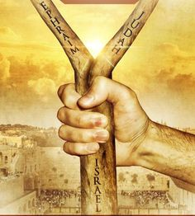
Ezekiel 37:15-28
יחזקאל לז טו-כח

Slide 2
Ezekiel 37:15-17
וַיְהִ֥י דְבַר־יְהוָ֖ה אֵלַ֥י לֵאמֹֽר׃
וְאַתָּ֣ה בֶן־אָדָ֗ם
קַח־לְךָ֙ עֵ֣ץ אֶחָ֔ד
וּכְתֹ֤ב עָלָיו֙ לִֽיהוּדָ֔ה
וְלִבְנֵ֥י יִשְׂרָאֵ֖ל חברו חֲבֵרָ֑יו
וּלְקַח֙ עֵ֣ץ אֶחָ֔ד
וּכְת֣וֹב עָלָ֗יו לְיוֹסֵף֙ עֵ֣ץ אֶפְרַ֔יִם
וְכָל־בֵּ֥ית יִשְׂרָאֵ֖ל חברו חֲבֵרָֽיו׃
וְקָרַ֨ב אֹתָ֜ם אֶחָ֧ד אֶל־אֶחָ֛ד לְךָ֖ לְעֵ֣ץ אֶחָ֑ד
וְהָי֥וּ לַאֲחָדִ֖ים בְּיָדֶֽךָ׃

Slide 3
Ezekiel 37:18-19
וְכַֽאֲשֶׁר֙ יֹאמְר֣וּ אֵלֶ֔יךָ בְּנֵ֥י עַמְּךָ֖ לֵאמֹ֑ר
הֲלֽוֹא־תַגִּ֥יד לָ֖נוּ מָה־אֵ֥לֶּה לָּֽךְ׃
דַּבֵּ֣ר אֲלֵהֶ֗ם
כֹּֽה־אָמַר֮ אֲדֹנָ֣י יְהוִה֒
הִנֵּה֩ אֲנִ֨י לֹקֵ֜חַ אֶת־עֵ֤ץ יוֹסֵף֙ אֲשֶׁ֣ר בְּיַד־אֶפְרַ֔יִם
וְשִׁבְטֵ֥י יִשְׂרָאֵ֖ל חברו חֲבֵרָ֑יו
וְנָתַתִּי֩ אוֹתָ֨ם עָלָ֜יו אֶת־עֵ֣ץ יְהוּדָ֗ה
וַֽעֲשִׂיתִם֙ לְעֵ֣ץ אֶחָ֔ד
וְהָי֥וּ אֶחָ֖ד בְּיָדִֽי׃

Slide 4
Aside
?

Slide 5
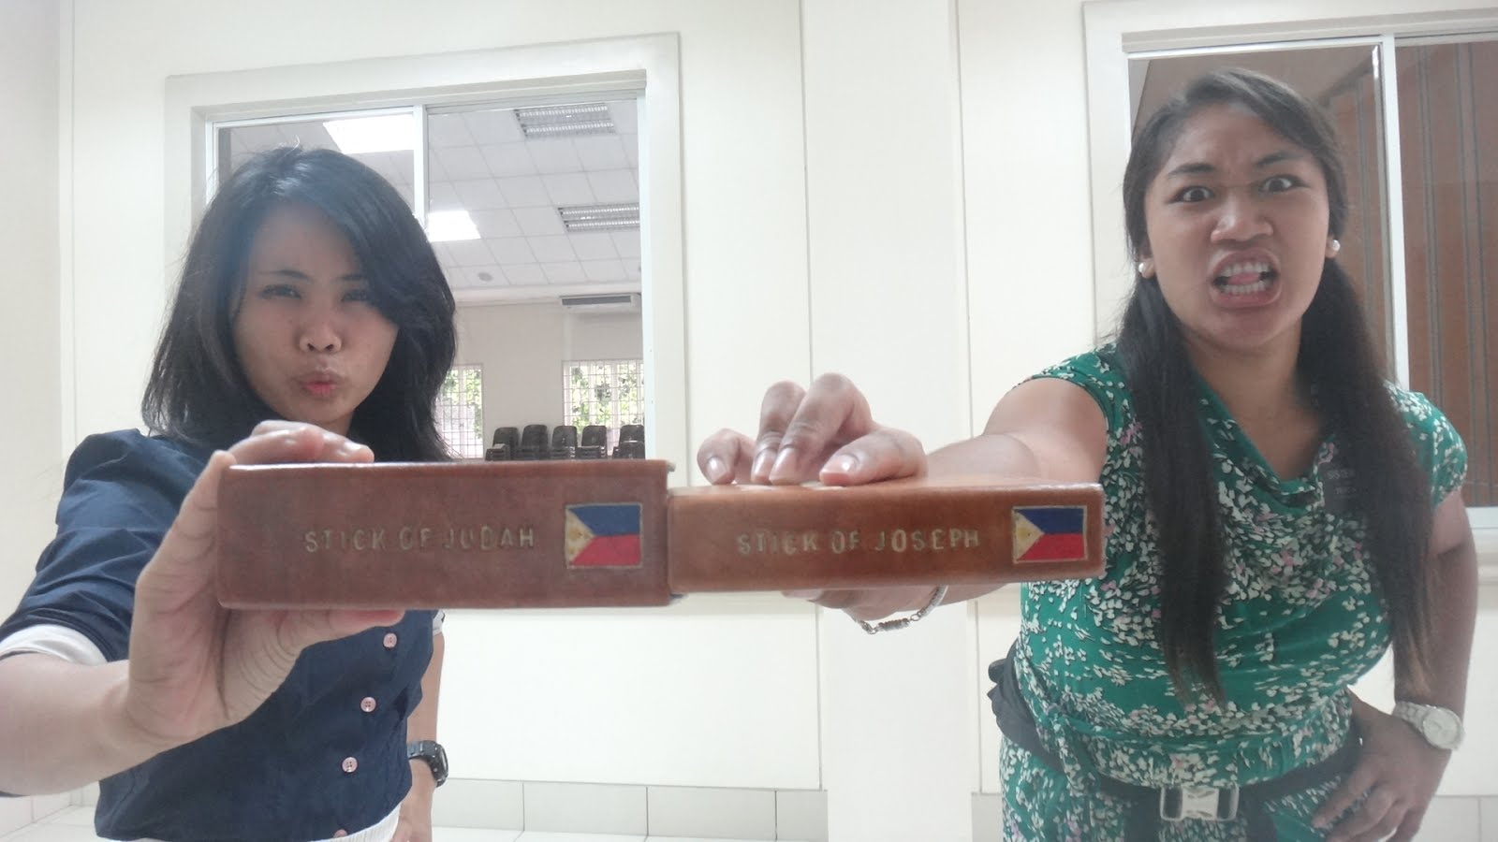
Aside
http://sisterdarleymaedula.blogspot.ca/

Slide 6
An LDS woman’s advice regarding going on mission or getting married.
Aside
Boyfriend or Mission?
I loved being a full-time missionary and I know it was part of God’s plan for me. I still smile when people from my mission call me “Hermana Williams.” But now I look forward to the time when I get the eternal titles of “wife” and “mother.”
…
A mission is a great life experience. It builds your testimony. You introduce people to the gospel and guide them to the path of true happiness. However, serving a mission is not a requirement for exaltation. Marriage is. The opportunity to make a covenant with God and continue to progress is one of the most important steps you can take in your life. In the words of Elder Jeffrey R. Holland, “I believe that second only to your membership in the Church, your ‘membership in a marriage’ is the most important association you will have in time and eternity.”
http://www.missiongeek.net/2015/06/boyfriend-mission/

Slide 7
What is LSD Exaltation?
Aside
When we lived with our Heavenly Father, He explained a plan for our progression. We could become like Him, an exalted being. The plan required that we be separated from Him and come to earth. This separation was necessary to prove whether we would obey our Father’s commandments even though we were no longer in His presence. The plan provided that when earth life ended, we would be judged and rewarded according to the degree of our faith and obedience.
…
Exaltation is eternal life, the kind of life God lives. He lives in great glory. He is perfect. He possesses all knowledge and all wisdom. He is the Father of spirit children. He is a creator. We can become like our Heavenly Father. This is exaltation.
If we prove faithful to the Lord, we will live in the highest degree of the celestial kingdom of heaven. We will become exalted, to live with our Heavenly Father in eternal families. Exaltation is the greatest gift that Heavenly Father can give His children (see D&C 14:7).
…
Our Heavenly Father is perfect, and He glories in the fact that it is possible for His children to become like Him.
…
They will become gods (see D&C 132:20–23).
https://www.lds.org/manual/gospel-principles/chapter-47-exaltation?lang=eng

Slide 8
Aside
Mormons rely greatly on the Ezekiel passage as a proof text to demonstrate not only the possibility of divine scripture aside from the Bible, but also the Book of Mormon's doctrinal equality with it. They assume that the "stick of Judah" is the Bible, while the "stick of Joseph" is the Book of Mormon. In these, the latter days, the two have been joined together, forming the bulk of Mormon scripture.
http://www.catholic.com/quickquestions/what-are-mormons-referring-to-when-they-talk-about-the-stick-of-joseph

Slide 9
Ezekiel 37:20-21
וְהָי֨וּ הָעֵצִ֜ים אֲ‍ֽשֶׁר־תִּכְתֹּ֧ב עֲלֵיהֶ֛ם בְּיָדְךָ֖ לְעֵינֵיהֶֽם׃
וְדַבֵּ֣ר אֲלֵיהֶ֗ם
כֹּֽה־אָמַר֮ אֲדֹנָ֣י יְהוִה֒
הִנֵּ֨ה אֲנִ֤י לֹקֵ֙חַ֙ אֶת־בְּנֵ֣י יִשְׂרָאֵ֔ל
מִבֵּ֥ין הַגּוֹיִ֖ם אֲשֶׁ֣ר הָֽלְכוּ־שָׁ֑ם
וְקִבַּצְתִּ֤י אֹתָם֙ מִסָּבִ֔יב
וְהֵבֵאתִ֥י אוֹתָ֖ם אֶל־אַדְמָתָֽם׃

Slide 10
Ezekiel 37:22-23
וְעָשִׂ֣יתִי אֹ֠תָם לְג֨וֹי אֶחָ֤ד בָּאָ֙רֶץ֙ בְּהָרֵ֣י יִשְׂרָאֵ֔ל
וּמֶ֧לֶךְ אֶחָ֛ד יִֽהְיֶ֥ה לְכֻלָּ֖ם לְמֶ֑לֶךְ
וְלֹ֤א יהיה־יִֽהְיוּ־עוֹד֙ לִשְׁנֵ֣י גוֹיִ֔ם
וְלֹ֨א יֵחָ֥צוּ ע֛וֹד לִשְׁתֵּ֥י מַמְלָכ֖וֹת עֽוֹד׃
וְלֹ֧א יִֽטַמְּא֣וּ ע֗וֹד בְּגִלּֽוּלֵיהֶם֙ וּבְשִׁקּ֣וּצֵיהֶ֔ם וּבְכֹ֖ל פִּשְׁעֵיהֶ֑ם
וְהוֹשַׁעְתִּ֣י אֹתָ֗ם מִכֹּ֤ל מוֹשְׁבֹֽתֵיהֶם֙ אֲשֶׁ֣ר חָטְא֣וּ בָהֶ֔ם
וְטִהַרְתִּ֤י אוֹתָם֙
וְהָיוּ־לִ֣י לְעָ֔ם
וַאֲנִ֕י אֶהְיֶ֥ה לָהֶ֖ם לֵאלֹהִֽים׃

Slide 11
Ezekiel 37:24-25
וְעַבְדִּ֤י דָוִד֙ מֶ֣לֶךְ עֲלֵיהֶ֔ם
וְרוֹעֶ֥ה אֶחָ֖ד יִהְיֶ֣ה לְכֻלָּ֑ם
וּבְמִשְׁפָּטַ֣י יֵלֵ֔כוּ
וְחֻקֹּתַ֥י יִשְׁמְר֖וּ וְעָשׂ֥וּ אוֹתָֽם׃
וְיָשְׁב֣וּ עַל־הָאָ֗רֶץ אֲשֶׁ֤ר נָתַ֙תִּי֙ לְעַבְדִּ֣י לְיַֽעֲקֹ֔ב
אֲשֶׁ֥ר יָֽשְׁבוּ־בָ֖הּ אֲבֽוֹתֵיכֶ֑ם
וְיָשְׁב֣וּ עָלֶ֡יהָ הֵ֠מָּה
וּבְנֵיהֶ֞ם וּבְנֵ֤י בְנֵיהֶם֙ עַד־עוֹלָ֔ם
וְדָוִ֣ד עַבְדִּ֔י נָשִׂ֥יא לָהֶ֖ם לְעוֹלָֽם׃

Slide 12
Ezekiel 37:26-27
וְכָרַתִּ֤י לָהֶם֙ בְּרִ֣ית שָׁל֔וֹם בְּרִ֥ית עוֹלָ֖ם יִהְיֶ֣ה אוֹתָ֑ם
וּנְתַתִּים֙
וְהִרְבֵּיתִ֣י אוֹתָ֔ם
וְנָתַתִּ֧י אֶת־מִקְדָּשִׁ֛י בְּתוֹכָ֖ם לְעוֹלָֽם׃
וְהָיָ֤ה מִשְׁכָּנִי֙ עֲלֵיהֶ֔ם
וְהָיִ֥יתִי לָהֶ֖ם לֵֽאלֹהִ֑ים
וְהֵ֖מָּה יִֽהְיוּ־לִ֥י לְעָֽם׃
וְיָֽדְעוּ֙ הַגּוֹיִ֔ם כִּ֚י אֲנִ֣י יְהוָ֔ה מְקַדֵּ֖שׁ אֶת־יִשְׂרָאֵ֑ל
בִּהְי֧וֹת מִקְדָּשִׁ֛י בְּתוֹכָ֖ם לְעוֹלָֽם׃

Slide 14
Ezekiel 37:26-27
וְכָרַתִּ֤י לָהֶם֙ בְּרִ֣ית שָׁל֔וֹם בְּרִ֥ית עוֹלָ֖ם יִהְיֶ֣ה אוֹתָ֑ם
וּנְתַתִּים֙
וְהִרְבֵּיתִ֣י אוֹתָ֔ם
וְנָתַתִּ֧י אֶת־מִקְדָּשִׁ֛י בְּתוֹכָ֖ם לְעוֹלָֽם׃
וְהָיָ֤ה מִשְׁכָּנִי֙ עֲלֵיהֶ֔ם
וְהָיִ֥יתִי לָהֶ֖ם לֵֽאלֹהִ֑ים
וְהֵ֖מָּה יִֽהְיוּ־לִ֥י לְעָֽם׃
וְיָֽדְעוּ֙ הַגּוֹיִ֔ם כִּ֚י אֲנִ֣י יְהוָ֔ה מְקַדֵּ֖שׁ אֶת־יִשְׂרָאֵ֑ל
בִּהְי֧וֹת מִקְדָּשִׁ֛י בְּתוֹכָ֖ם לְעוֹלָֽם׃
Is this the 3rd temple?
Is Israel here ultimately the church (Jew and Gentile)?
No temple in the New Jerusalem (Rev 21:22).
New Jerusalem includes both 12 tribes (v12) and 12 apostles (v14).
Who are the nations in the eschaton (Rev 21-22)?

