Slide 1
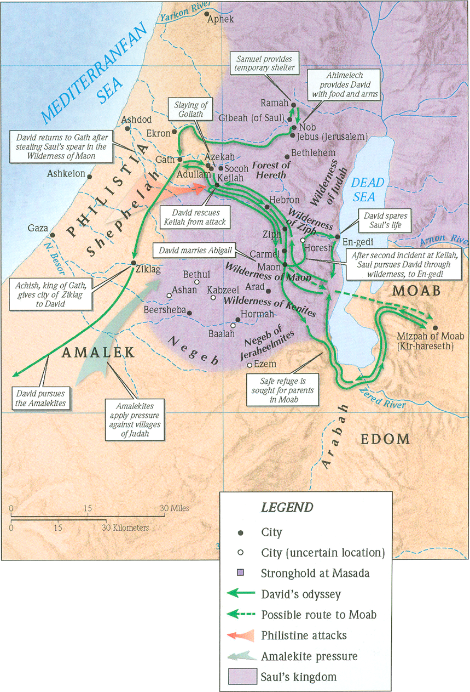
1 Samuel 17
שמואל א יז

Slide 2
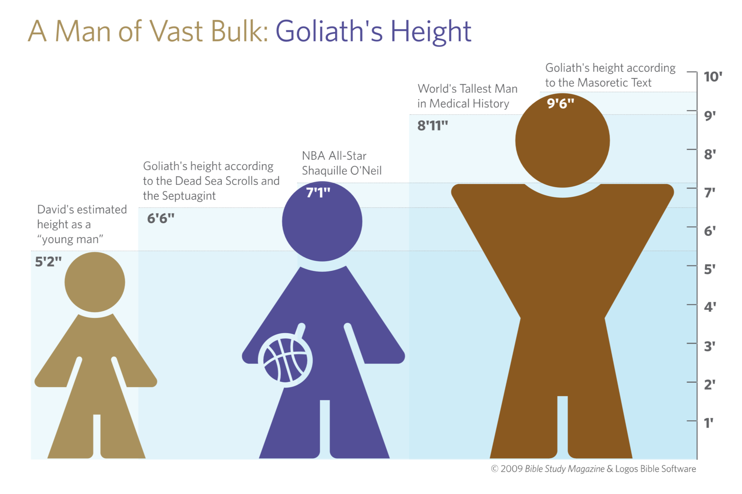

Slide 3
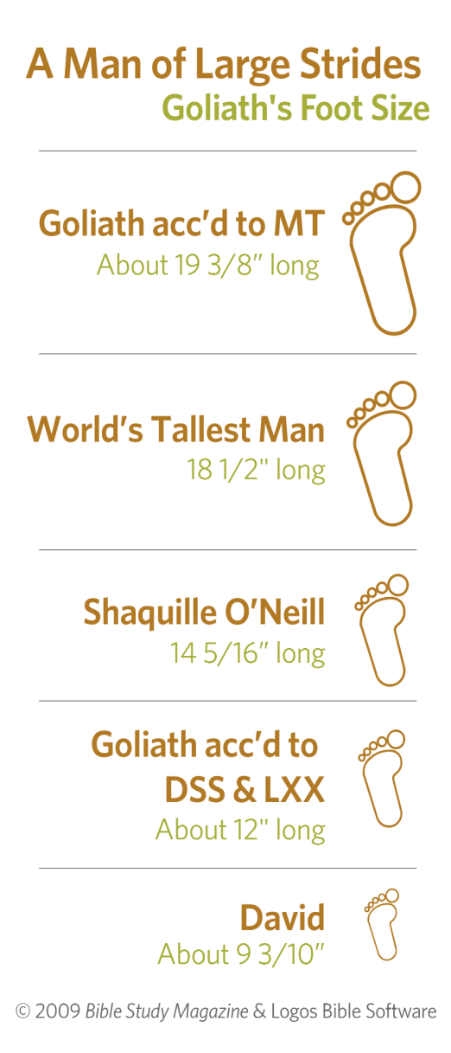

Slide 4
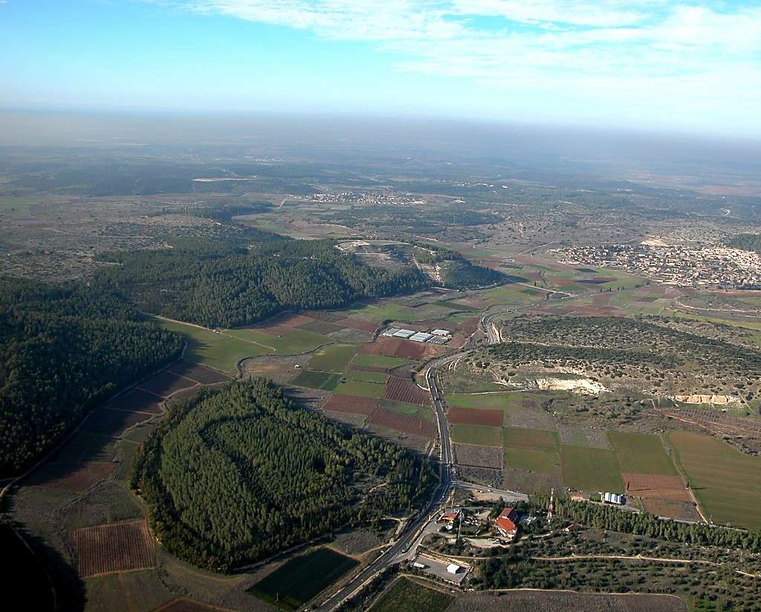
Elah Valley and Azekah aerial from south
1 Samuel 17 says that the Philistines were encamped between Socoh and Azekah, at Ephes-Dammim. The location of Ephes-Dammim has not been identified with certainty, but it is an interesting name, literally meaning “zero blood” in Hebrew.
To Beth Shemesh
Azekah
https://www.bibleplaces.com/
Ephes-dammim?
Order from
Elah Valley and Azekah aerial from south
Notes:
1 Samuel 17 says that the Philistines were encamped between Socoh and Azekah, at Ephes-Dammim. The location of Ephes-Dammim has not been identified with certainty, but it is an interesting name, literally meaning “zero blood” in Hebrew.

Slide 5
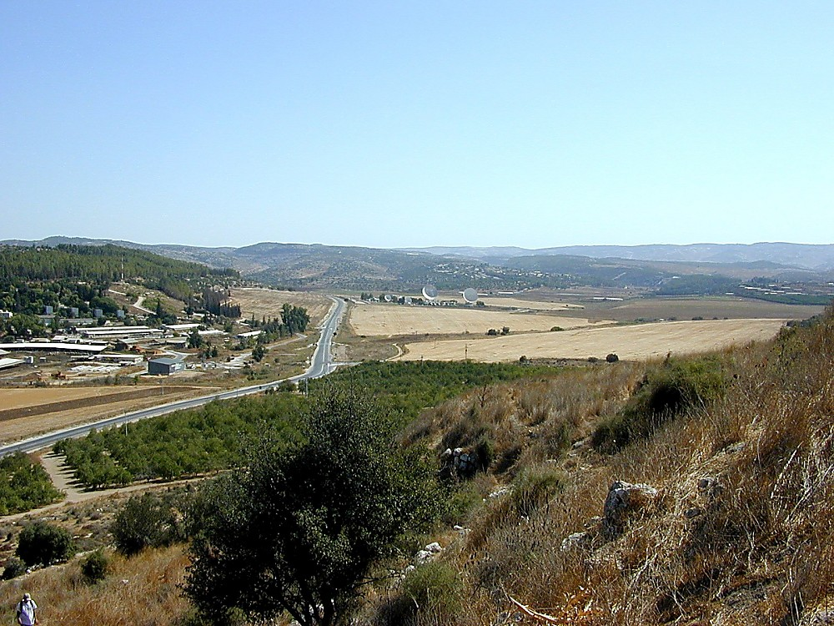
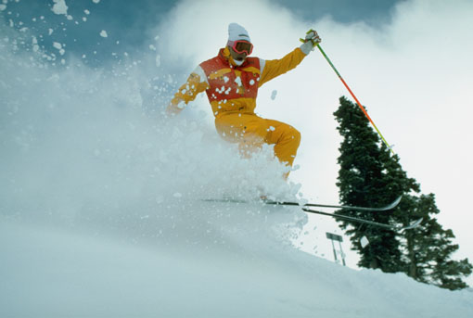
Elah Valley east end from Socoh
https://www.bibleplaces.com/
Order from
Elah Valley east end from Socoh

Slide 6
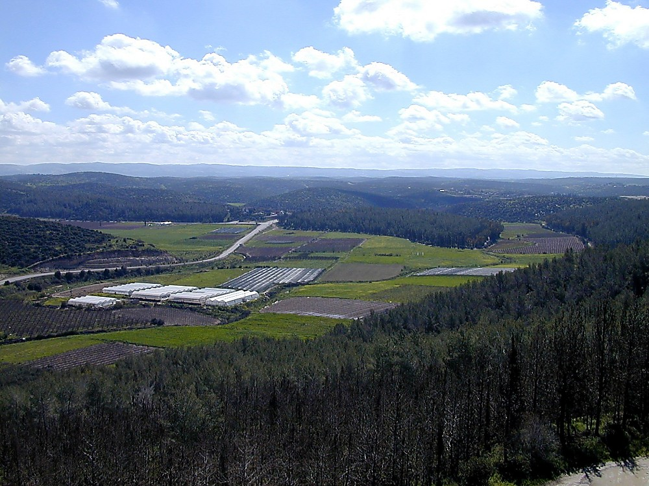
Elah Valley from Azekah
https://www.bibleplaces.com/
Order from
Elah Valley from Azekah
Notes:
1 Samuel 17:1 (ESV) “Now the Philistines gathered their armies for battle. And they were gathered at Socoh, which belongs to Judah, and encamped between Socoh and Azekah, in Ephes-dammim.”

Slide 7
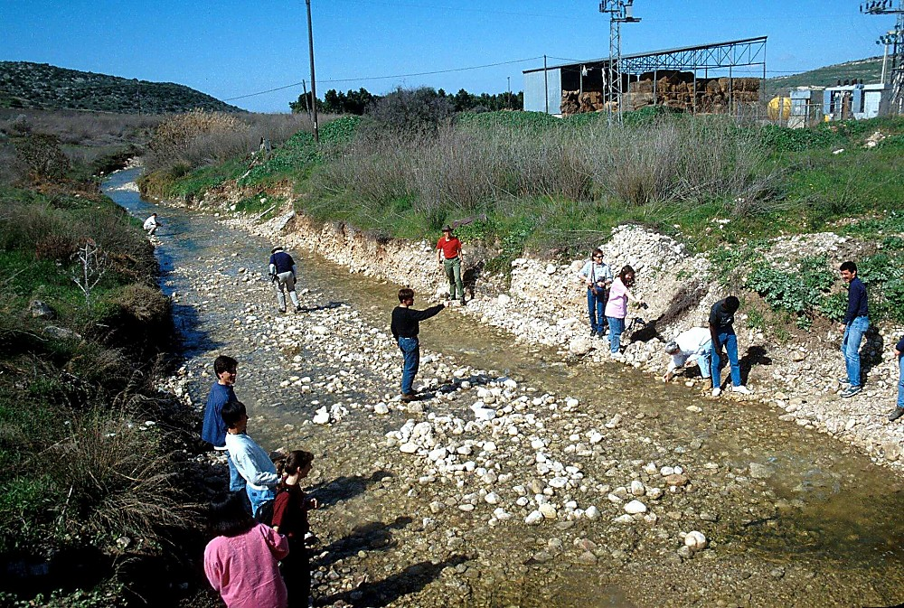
Picking up smooth stones in the Elah brook
https://www.bibleplaces.com/
Picking up smooth stones in the Elah brook
Order from
Notes:
1 Samuel 17:40 (NIV) “Then he took his staff in his hand; and he chose for himself five smooth stones from the brook, and put them in a shepherd’s bag, in a pouch which he had, and his sling was in his hand. And he drew near to the Philistine.”

Slide 8
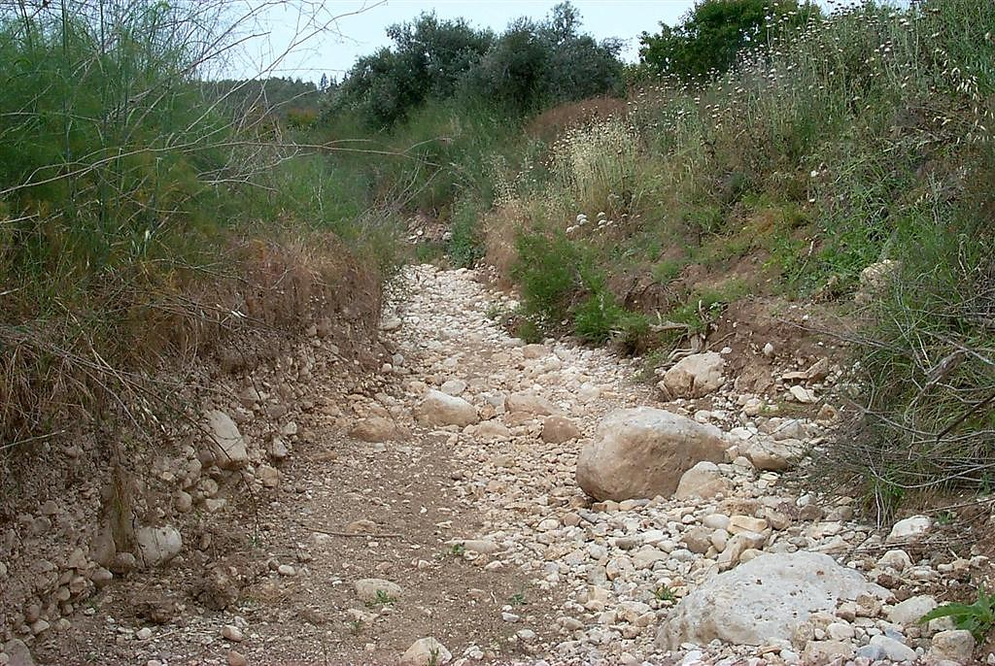
Brook of Elah
https://www.bibleplaces.com/
Order from
Brook of Elah

Slide 9
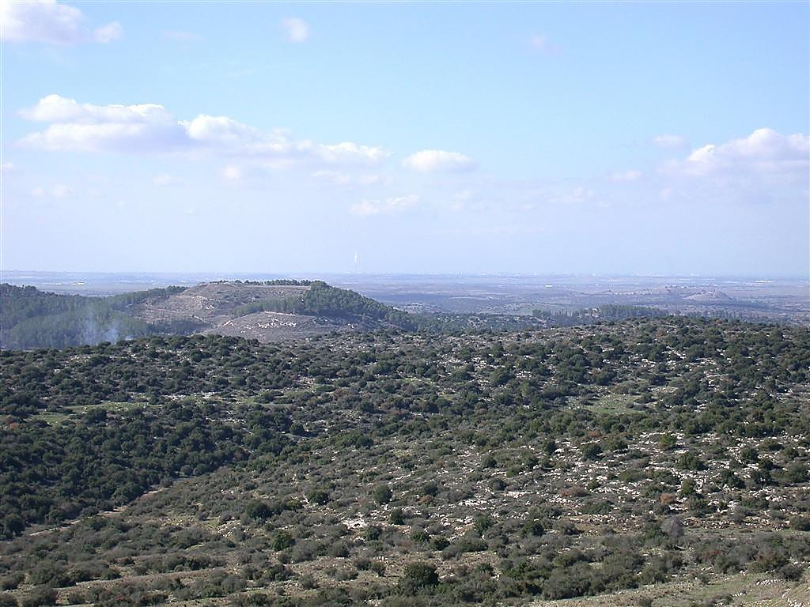
Azekah and Gath from Yarmuth
Azekah
Gath
https://www.bibleplaces.com/
Order from
Azekah and Gath from Yarmuth
Notes:
Azekah: Historical Events
Joshua’s campaigns in central Canaan mention Azekah. Joshua chased the Canaanites as far as Azekah and Makkedah (Josh 10:10-11). There was most likely a Canaanite fort at Azekah.
Rehoboam fortified Azekah (2 Chr 11:9).
There is a reference to Azekah in a late-8th-century, Assyrian document (likely connected with either Sargon II or Sennacherib). “I returned a second time to the land of Judah. The city of Azekah is a stronghold which is situated in the midst of the mountains, located on a mountain range like a pointed dagger, it was like an eagle’s nest and rivaled the highest mountains and was inaccessible even for the siege ramps and for approaching with battering rams it was too strong.”
Azekah was one of the last cities to hold out in the Babylonian invasion of 588-586 B.C. Both Jeremiah and an ostracon found at Lachish attest to this.
Jeremiah 34:7 (NIV) “…while the army of the king of Babylon was fighting against Jerusalem and the other cities of Judah that were still holding out ― Lachish and Azekah. These were the only fortified cities left in Judah.”
Lachish Letter #4: “And may my Lord know that we are watching for the signal fires of Lachish according to all the signs which my Lord has given, because we cannot see Azekah.”
Azekah was resettled after the return from the Babylonian exile (Neh 11:30).
During the Byzantine period, there was a village named Azekah near the present tell. The remains of this Byzantine village are known as Khirbet el-Alami (Eusebius, Onomasticon 18:12).

Slide 10
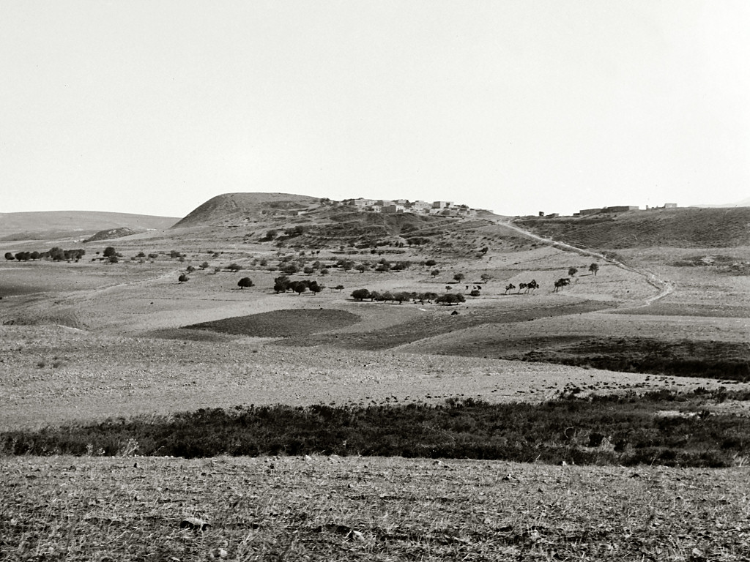
Azekah, Tell Zacharia
https://www.bibleplaces.com/
Order from
Azekah, Tell Zacharia (Date of photograph: 1910-1926)
Notes:
“Azekah.-This town occurs in the same list with Shocoh (Josh. xv. 35), as in the Shephelah. The only other indication of its position is to be found in the account of the flight of the defeated Canaanites from Ajalon to Makkedah and Azekah (Josh x. 10). In the topographical list Azekah stands between Shocoh and Shaaraim. It must therefore be sought in the Shephelah, but the same reasons which induce us to place Makkedah at El Moghar—namely, the distance from Gibeon, and the relative position with the mouth of the valley of Ajalon—would point to Azekah being near the north boundary of Judah, and close to the plain. Azekah has been placed by some writers at Tell Zekaría, but to this there is the objection of an important difference in name” (Conder 1875b: 191).
Date of photograph: between 1910 and 1926
mat01392

Slide 11
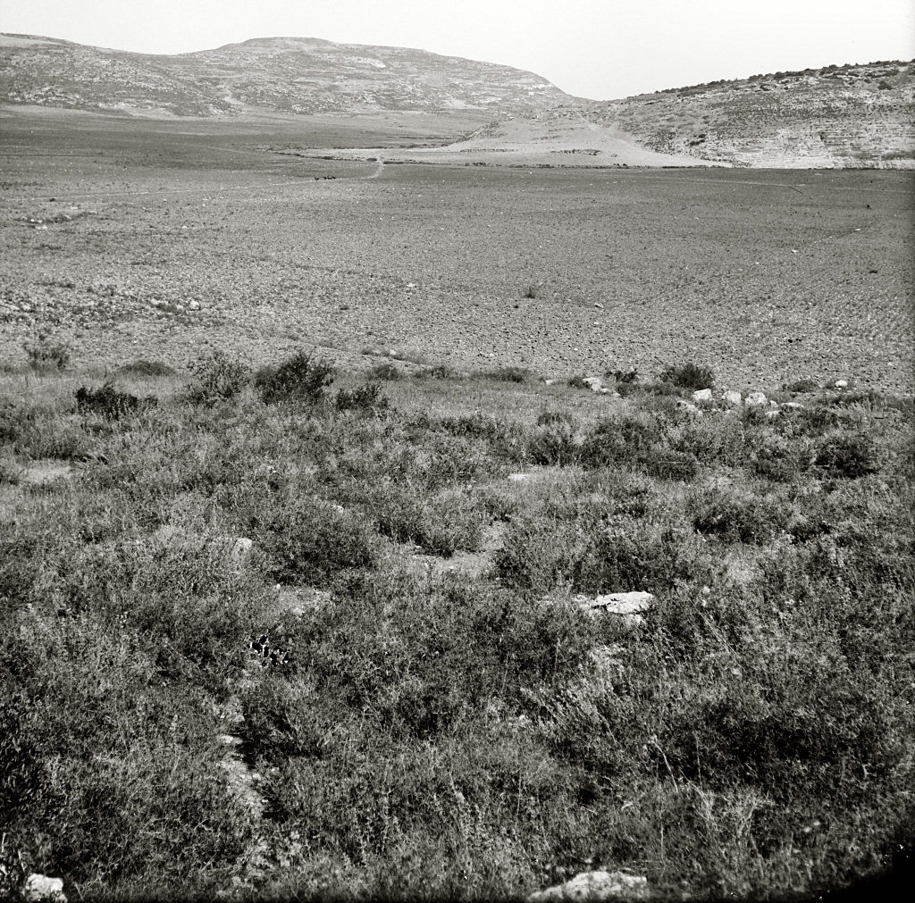
Elah Valley and Azekah from southeast
Elah Valley and Azekah from southeast
https://www.bibleplaces.com/
Date of photograph:
approx. 1900-1926
Order from
Notes:
“The third valley which cuts the Shephelah is the Wady es Sunt, which, when it gets to the back of the low hills, turns south into the Wady es Sur, the great trench between the Shephelah and Judah . . . . The Wady es Sunt is probably the Vale of Elah. Its entrance from the Philistine Plain is commanded by the famous Tell-es-Safiyeh, the Blanchegarde of the Crusaders, whose high white front looks west across the plain twelve miles to Ashdod” (Smith 1909: 227).
Date of photograph: approximately 1900 to 1926
mat11415

Slide 12
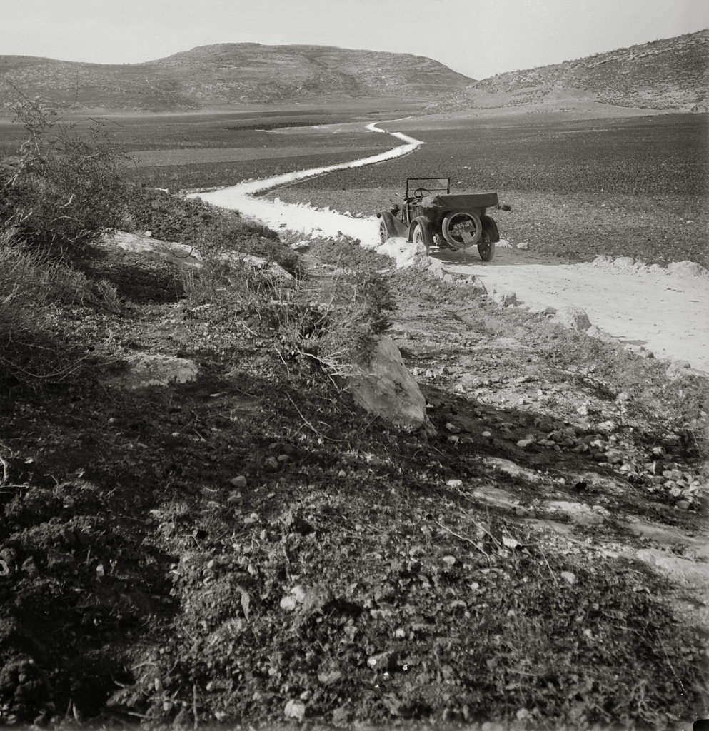
Elah Valley and Azekah from southeast
Elah Valley and Azekah from southeast
https://www.bibleplaces.com/
Date of photograph:
approx. 1898-1946
Order from
Notes:
“This Valley of Elah (or the Terebinth) at the present day contain, Shocoh (Shuweikeh), one of the largest terebinth-trees in Palestine, fifty-five feet in height, with a spread of shade seventy-five feet in diameter, and a trunk seventeen feet in circumferences. The bottom of this valley, near Shocoh, is a fine fertile plain, cultivated as corn-fields, and here it was that the encounter between David and Goliath took place, the Philistines standing on a mountain on one side, and Israel on a mountain on the other, with the valley between them” (Wilson 1881: 3: 158).
Date of photograph: between 1898 and 1946
mat09273

Slide 13
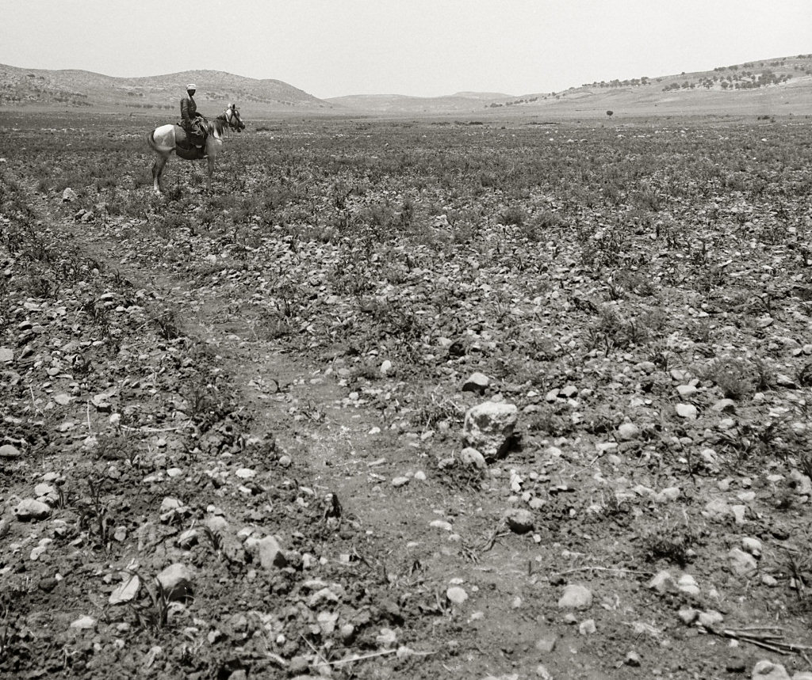
Elah Valley, general view
https://www.bibleplaces.com/
Order from
Elah Valley, general view (Date of photograph: 1910-1926)
Notes:
“The valley itself is well known to be the great valley rising near Hebron, and running northwards by Keilah, Nezib, and Adullam to Shochoh, and thence westwards to the sea by Gath and Ashdod. The Hebrew ‘Valley of Terebinths’ receives the name of Wady Súr in the upper part of its course, and Wady Sumt (the acacia) in the lower, becoming finally a deep gully under the name of Nahr Sukereir. Nevertheless the cause of its original title is still traceable in the number of huge terebinths which occur along its course” (Conder 1875b: 193).
“This great natural division of the Shephelah is still the highway from Hebron to the plain, and seems in all the early periods of Jewish history to have been the scene of constant fighting. Holding Gath and Shaaraim the Philistines held the key to the plain, and a strong outpost for attack upon the Shephelah” (Conder 1875b: 193).
Date of photograph: between 1910 and 1926
mat01391

