Slide 1
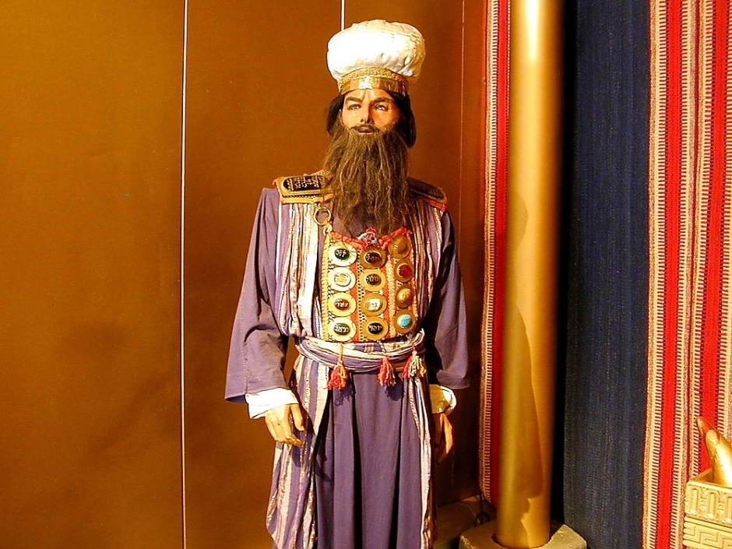
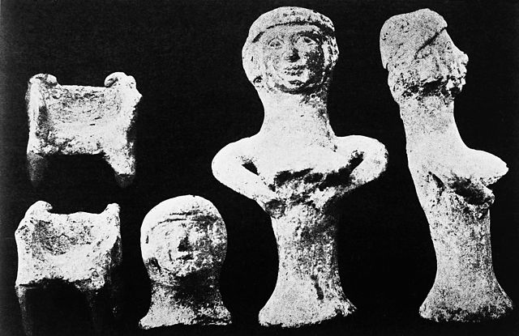
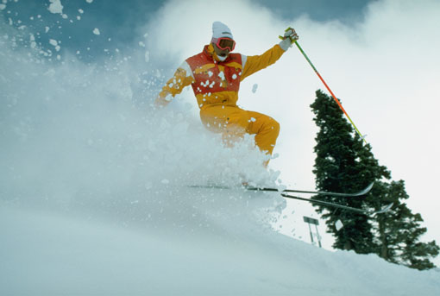
Ephod on the High Priest
Teraphim (idol). Figurines of a fertility goddess placed in ancient Canaanite houses to ensure health.
Bible Places Pictures
https://commons.wikimedia.org/wiki/File:Ancient_Canaanite_Teraphim._Figurines_of_fertility_goddess._Wellcome_M0008439.jpg
Judges 17
שֹׁפְטִים יז

Slide 2
Judges 17:1-5
וַיָּ֥שֶׁב אֶת־הַכֶּ֖סֶף לְאִמּ֑וֹ
וַתִּקַּ֣ח אִמּוֹ֩ מָאתַ֨יִם כֶּ֜סֶף
וַתִּתְּנֵ֣הוּ לַצּוֹרֵ֗ף
וַֽיַּעֲשֵׂ֙הוּ֙ פֶּ֣סֶל וּמַסֵּכָ֔ה
וַיְהִ֖י בְּבֵ֥ית מִיכָֽיְהוּ׃
וְהָאִ֣ישׁ מִיכָ֔ה ל֖וֹ בֵּ֣ית אֱלֹהִ֑ים
וַיַּ֤עַשׂ אֵפוֹד֙ וּתְרָפִ֔ים
וַיְמַלֵּ֗א אֶת־יַ֤ד אַחַד֙ מִבָּנָ֔יו
וַיְהִי־ל֖וֹ לְכֹהֵֽן׃
4
וַֽיְהִי־אִ֥ישׁ מֵֽהַר־אֶפְרָ֖יִם וּשְׁמ֥וֹ מִיכָֽיְהוּ׃
וַיֹּ֣אמֶר לְאִמּ֡וֹ
אֶלֶף֩ וּמֵאָ֨ה הַכֶּ֜סֶף אֲשֶׁ֣ר לֻֽקַּֽח־לָ֗ךְ
ואתי וְאַ֤תְּ אָלִית֙ וְגַם֙ אָמַ֣רְתְּ בְּאָזְנַ֔י
הִנֵּֽה־הַכֶּ֥סֶף אִתִּ֖י
אֲנִ֣י לְקַחְתִּ֑יו
וַתֹּ֣אמֶר אִמּ֔וֹ
בָּר֥וּךְ בְּנִ֖י לַיהוָֽה׃
וַיָּ֛שֶׁב אֶת־אֶֽלֶף־וּמֵאָ֥ה הַכֶּ֖סֶף לְאִמּ֑וֹ
וַתֹּ֣אמֶר אִמּ֡וֹ
הַקְדֵּ֣שׁ הִקְדַּ֣שְׁתִּי אֶת־הַכֶּסֶף֩ לַיהוָ֨ה
מִיָּדִ֜י לִבְנִ֗י לַֽעֲשׂוֹת֙ פֶּ֣סֶל וּמַסֵּכָ֔ה
וְעַתָּ֖ה אֲשִׁיבֶ֥נּוּ לָֽךְ׃
1
2
5
3

Slide 3
Judges 17:1-5
Now mother has the money
וַיָּ֥שֶׁב אֶת־הַכֶּ֖סֶף לְאִמּ֑וֹ
וַתִּקַּ֣ח אִמּוֹ֩ מָאתַ֨יִם כֶּ֜סֶף
וַתִּתְּנֵ֣הוּ לַצּוֹרֵ֗ף
וַֽיַּעֲשֵׂ֙הוּ֙ פֶּ֣סֶל וּמַסֵּכָ֔ה
וַיְהִ֖י בְּבֵ֥ית מִיכָֽיְהוּ׃
וְהָאִ֣ישׁ מִיכָ֔ה ל֖וֹ בֵּ֣ית אֱלֹהִ֑ים
וַיַּ֤עַשׂ אֵפוֹד֙ וּתְרָפִ֔ים
וַיְמַלֵּ֗א אֶת־יַ֤ד אַחַד֙ מִבָּנָ֔יו
וַיְהִי־ל֖וֹ לְכֹהֵֽן׃
4
וַֽיְהִי־אִ֥ישׁ מֵֽהַר־אֶפְרָ֖יִם וּשְׁמ֥וֹ מִיכָֽיְהוּ׃
וַיֹּ֣אמֶר לְאִמּ֡וֹ
אֶלֶף֩ וּמֵאָ֨ה הַכֶּ֜סֶף אֲשֶׁ֣ר לֻֽקַּֽח־לָ֗ךְ
ואתי וְאַ֤תְּ אָלִית֙ וְגַם֙ אָמַ֣רְתְּ בְּאָזְנַ֔י
הִנֵּֽה־הַכֶּ֥סֶף אִתִּ֖י
אֲנִ֣י לְקַחְתִּ֑יו
וַתֹּ֣אמֶר אִמּ֔וֹ
בָּר֥וּךְ בְּנִ֖י לַיהוָֽה׃
וַיָּ֛שֶׁב אֶת־אֶֽלֶף־וּמֵאָ֥ה הַכֶּ֖סֶף לְאִמּ֑וֹ
וַתֹּ֣אמֶר אִמּ֡וֹ
הַקְדֵּ֣שׁ הִקְדַּ֣שְׁתִּי אֶת־הַכֶּסֶף֩ לַיהוָ֨ה
מִיָּדִ֜י לִבְנִ֗י לַֽעֲשׂוֹת֙ פֶּ֣סֶל וּמַסֵּכָ֔ה
וְעַתָּ֖ה אֲשִׁיבֶ֥נּוּ לָֽךְ׃
1
Mother pays the refiner
Mother had some money
2
5
Son took the money
Now mother has the money
3
Now son has the money

Slide 4
Judges 17:1-5
Now mother has the money
וַיָּ֥שֶׁב אֶת־הַכֶּ֖סֶף לְאִמּ֑וֹ
וַתִּקַּ֣ח אִמּוֹ֩ מָאתַ֨יִם כֶּ֜סֶף
וַתִּתְּנֵ֣הוּ לַצּוֹרֵ֗ף
וַֽיַּעֲשֵׂ֙הוּ֙ פֶּ֣סֶל וּמַסֵּכָ֔ה
וַיְהִ֖י בְּבֵ֥ית מִיכָֽיְהוּ׃
וְהָאִ֣ישׁ מִיכָ֔ה ל֖וֹ בֵּ֣ית אֱלֹהִ֑ים
וַיַּ֤עַשׂ אֵפוֹד֙ וּתְרָפִ֔ים
וַיְמַלֵּ֗א אֶת־יַ֤ד אַחַד֙ מִבָּנָ֔יו
וַיְהִי־ל֖וֹ לְכֹהֵֽן׃
4
וַֽיְהִי־אִ֥ישׁ מֵֽהַר־אֶפְרָ֖יִם וּשְׁמ֥וֹ מִיכָֽיְהוּ׃
וַיֹּ֣אמֶר לְאִמּ֡וֹ
אֶלֶף֩ וּמֵאָ֨ה הַכֶּ֜סֶף אֲשֶׁ֣ר לֻֽקַּֽח־לָ֗ךְ
ואתי וְאַ֤תְּ אָלִית֙ וְגַם֙ אָמַ֣רְתְּ בְּאָזְנַ֔י
הִנֵּֽה־הַכֶּ֥סֶף אִתִּ֖י
אֲנִ֣י לְקַחְתִּ֑יו
וַתֹּ֣אמֶר אִמּ֔וֹ
בָּר֥וּךְ בְּנִ֖י לַיהוָֽה׃
וַיָּ֛שֶׁב אֶת־אֶֽלֶף־וּמֵאָ֥ה הַכֶּ֖סֶף לְאִמּ֑וֹ
וַתֹּ֣אמֶר אִמּ֡וֹ
הַקְדֵּ֣שׁ הִקְדַּ֣שְׁתִּי אֶת־הַכֶּסֶף֩ לַיהוָ֨ה
מִיָּדִ֜י לִבְנִ֗י לַֽעֲשׂוֹת֙ פֶּ֣סֶל וּמַסֵּכָ֔ה
וְעַתָּ֖ה אֲשִׁיבֶ֥נּוּ לָֽךְ׃
1
Mother pays the refiner
Mother had some money
2
5
Son took the money
Now mother has the money
3
Why does the mother give the money to her son, when she is going to pay the refiner in the next verse?
He now has to give it back to her a second time so she can pay the refiner. (See NET Bible notes)
Now son has the money

Slide 5

Judges 17:1-5
Now mother has the money
וַיָּ֥שֶׁב אֶת־הַכֶּ֖סֶף לְאִמּ֑וֹ
וַתִּקַּ֣ח אִמּוֹ֩ מָאתַ֨יִם כֶּ֜סֶף
וַתִּתְּנֵ֣הוּ לַצּוֹרֵ֗ף
וַֽיַּעֲשֵׂ֙הוּ֙ פֶּ֣סֶל וּמַסֵּכָ֔ה
וַיְהִ֖י בְּבֵ֥ית מִיכָֽיְהוּ׃
וְהָאִ֣ישׁ מִיכָ֔ה ל֖וֹ בֵּ֣ית אֱלֹהִ֑ים
וַיַּ֤עַשׂ אֵפוֹד֙ וּתְרָפִ֔ים
וַיְמַלֵּ֗א אֶת־יַ֤ד אַחַד֙ מִבָּנָ֔יו
וַיְהִי־ל֖וֹ לְכֹהֵֽן׃
4
וַֽיְהִי־אִ֥ישׁ מֵֽהַר־אֶפְרָ֖יִם וּשְׁמ֥וֹ מִיכָֽיְהוּ׃
וַיֹּ֣אמֶר לְאִמּ֡וֹ
אֶלֶף֩ וּמֵאָ֨ה הַכֶּ֜סֶף אֲשֶׁ֣ר לֻֽקַּֽח־לָ֗ךְ
ואתי וְאַ֤תְּ אָלִית֙ וְגַם֙ אָמַ֣רְתְּ בְּאָזְנַ֔י
הִנֵּֽה־הַכֶּ֥סֶף אִתִּ֖י
אֲנִ֣י לְקַחְתִּ֑יו
וַתֹּ֣אמֶר אִמּ֔וֹ
בָּר֥וּךְ בְּנִ֖י לַיהוָֽה׃
וַיָּ֛שֶׁב אֶת־אֶֽלֶף־וּמֵאָ֥ה הַכֶּ֖סֶף לְאִמּ֑וֹ
וַתֹּ֣אמֶר אִמּ֡וֹ
הַקְדֵּ֣שׁ הִקְדַּ֣שְׁתִּי אֶת־הַכֶּסֶף֩ לַיהוָ֨ה
מִיָּדִ֜י לִבְנִ֗י לַֽעֲשׂוֹת֙ פֶּ֣סֶל וּמַסֵּכָ֔ה
וְעַתָּ֖ה אֲשִׁיבֶ֥נּוּ לָֽךְ׃
1
Mother pays the refiner
Mother had some money
2
5
Son took the money
Now mother has the money
3
Why does the mother give the money to her son, when she is going to pay the refiner in the next verse?
He now has to give it back to her a second time so she can pay the refiner. (See NET Bible notes)
Now son has the money

Slide 6
Judges 17:1-5
Now mother has the money
וַיָּ֥שֶׁב אֶת־הַכֶּ֖סֶף לְאִמּ֑וֹ
וַתִּקַּ֣ח אִמּוֹ֩ מָאתַ֨יִם כֶּ֜סֶף
וַתִּתְּנֵ֣הוּ לַצּוֹרֵ֗ף
וַֽיַּעֲשֵׂ֙הוּ֙ פֶּ֣סֶל וּמַסֵּכָ֔ה
וַיְהִ֖י בְּבֵ֥ית מִיכָֽיְהוּ׃
וְהָאִ֣ישׁ מִיכָ֔ה ל֖וֹ בֵּ֣ית אֱלֹהִ֑ים
וַיַּ֤עַשׂ אֵפוֹד֙ וּתְרָפִ֔ים
וַיְמַלֵּ֗א אֶת־יַ֤ד אַחַד֙ מִבָּנָ֔יו
וַיְהִי־ל֖וֹ לְכֹהֵֽן׃
4
וַֽיְהִי־אִ֥ישׁ מֵֽהַר־אֶפְרָ֖יִם וּשְׁמ֥וֹ מִיכָֽיְהוּ׃
וַיֹּ֣אמֶר לְאִמּ֡וֹ
אֶלֶף֩ וּמֵאָ֨ה הַכֶּ֜סֶף אֲשֶׁ֣ר לֻֽקַּֽח־לָ֗ךְ
ואתי וְאַ֤תְּ אָלִית֙ וְגַם֙ אָמַ֣רְתְּ בְּאָזְנַ֔י
הִנֵּֽה־הַכֶּ֥סֶף אִתִּ֖י
אֲנִ֣י לְקַחְתִּ֑יו
וַתֹּ֣אמֶר אִמּ֔וֹ
בָּר֥וּךְ בְּנִ֖י לַיהוָֽה׃
וַיָּ֛שֶׁב אֶת־אֶֽלֶף־וּמֵאָ֥ה הַכֶּ֖סֶף לְאִמּ֑וֹ
וַתֹּ֣אמֶר אִמּ֡וֹ
הַקְדֵּ֣שׁ הִקְדַּ֣שְׁתִּי אֶת־הַכֶּסֶף֩ לַיהוָ֨ה
מִיָּדִ֜י לִבְנִ֗י לַֽעֲשׂוֹת֙ פֶּ֣סֶל וּמַסֵּכָ֔ה
וְעַתָּ֖ה אֲשִׁיבֶ֥נּוּ לָֽךְ׃
1
Mother pays the refiner
Mother had some money
2
5
Son took the money
Now mother has the money
3
NET Bible: In the Hebrew text the statement, "but now I am giving it back to you," appears at the end of v. 3 and is spoken by the mother. But v. 4 indicates that she did not give the money back to her son. Unless the statement is spoken by the woman to the LORD, it appears to be misplaced and fits much better in v. 2. It may have been accidentally omitted from a manuscript, written in the margin, and then later inserted in the wrong place in another manuscript.
Now son has the money

Slide 7
Judges 17:1-5
Now mother has the money
וַיָּ֥שֶׁב אֶת־הַכֶּ֖סֶף לְאִמּ֑וֹ
וַתִּקַּ֣ח אִמּוֹ֩ מָאתַ֨יִם כֶּ֜סֶף
וַתִּתְּנֵ֣הוּ לַצּוֹרֵ֗ף
וַֽיַּעֲשֵׂ֙הוּ֙ פֶּ֣סֶל וּמַסֵּכָ֔ה
וַיְהִ֖י בְּבֵ֥ית מִיכָֽיְהוּ׃
וְהָאִ֣ישׁ מִיכָ֔ה ל֖וֹ בֵּ֣ית אֱלֹהִ֑ים
וַיַּ֤עַשׂ אֵפוֹד֙ וּתְרָפִ֔ים
וַיְמַלֵּ֗א אֶת־יַ֤ד אַחַד֙ מִבָּנָ֔יו
וַיְהִי־ל֖וֹ לְכֹהֵֽן׃
4
וַֽיְהִי־אִ֥ישׁ מֵֽהַר־אֶפְרָ֖יִם וּשְׁמ֥וֹ מִיכָֽיְהוּ׃
וַיֹּ֣אמֶר לְאִמּ֡וֹ
אֶלֶף֩ וּמֵאָ֨ה הַכֶּ֜סֶף אֲשֶׁ֣ר לֻֽקַּֽח־לָ֗ךְ
ואתי וְאַ֤תְּ אָלִית֙ וְגַם֙ אָמַ֣רְתְּ בְּאָזְנַ֔י
הִנֵּֽה־הַכֶּ֥סֶף אִתִּ֖י
אֲנִ֣י לְקַחְתִּ֑יו
וַתֹּ֣אמֶר אִמּ֔וֹ
בָּר֥וּךְ בְּנִ֖י לַיהוָֽה׃
וַיָּ֛שֶׁב אֶת־אֶֽלֶף־וּמֵאָ֥ה הַכֶּ֖סֶף לְאִמּ֑וֹ
וַתֹּ֣אמֶר אִמּ֡וֹ
הַקְדֵּ֣שׁ הִקְדַּ֣שְׁתִּי אֶת־הַכֶּסֶף֩ לַיהוָ֨ה
מִיָּדִ֜י לִבְנִ֗י לַֽעֲשׂוֹת֙ פֶּ֣סֶל וּמַסֵּכָ֔ה
וְעַתָּ֖ה אֲשִׁיבֶ֥נּוּ לָֽךְ׃
1
Mother pays the refiner
Mother had some money
2
NET Bible Judges 17:2
He said to his mother,
"You know the eleven hundred pieces of silver which
were stolen from you,
about which I heard you pronounce a curse?
Look here, I have the silver.
I stole it,
but now I am giving it back to you."
His mother said,
"May the LORD reward you, my son!"
5
Son took the money
Now mother has the money
3
NET Bible: In the Hebrew text the statement, "but now I am giving it back to you," appears at the end of v. 3 and is spoken by the mother. But v. 4 indicates that she did not give the money back to her son. Unless the statement is spoken by the woman to the LORD, it appears to be misplaced and fits much better in v. 2. It may have been accidentally omitted from a manuscript, written in the margin, and then later inserted in the wrong place in another manuscript.
Now son has the money

Slide 8
Judges 17:1-5
וַיָּ֥שֶׁב אֶת־הַכֶּ֖סֶף לְאִמּ֑וֹ
וַתִּקַּ֣ח אִמּוֹ֩ מָאתַ֨יִם כֶּ֜סֶף
וַתִּתְּנֵ֣הוּ לַצּוֹרֵ֗ף
וַֽיַּעֲשֵׂ֙הוּ֙ פֶּ֣סֶל וּמַסֵּכָ֔ה
וַיְהִ֖י בְּבֵ֥ית מִיכָֽיְהוּ׃
וְהָאִ֣ישׁ מִיכָ֔ה ל֖וֹ בֵּ֣ית אֱלֹהִ֑ים
וַיַּ֤עַשׂ אֵפוֹד֙ וּתְרָפִ֔ים
וַיְמַלֵּ֗א אֶת־יַ֤ד אַחַד֙ מִבָּנָ֔יו
וַיְהִי־ל֖וֹ לְכֹהֵֽן׃
4
וַֽיְהִי־אִ֥ישׁ מֵֽהַר־אֶפְרָ֖יִם וּשְׁמ֥וֹ מִיכָֽיְהוּ׃
וַיֹּ֣אמֶר לְאִמּ֡וֹ
אֶלֶף֩ וּמֵאָ֨ה הַכֶּ֜סֶף אֲשֶׁ֣ר לֻֽקַּֽח־לָ֗ךְ
ואתי וְאַ֤תְּ אָלִית֙ וְגַם֙ אָמַ֣רְתְּ בְּאָזְנַ֔י
הִנֵּֽה־הַכֶּ֥סֶף אִתִּ֖י
אֲנִ֣י לְקַחְתִּ֑יו
וַתֹּ֣אמֶר אִמּ֔וֹ
בָּר֥וּךְ בְּנִ֖י לַיהוָֽה׃
וַיָּ֛שֶׁב אֶת־אֶֽלֶף־וּמֵאָ֥ה הַכֶּ֖סֶף לְאִמּ֑וֹ
וַתֹּ֣אמֶר אִמּ֡וֹ
הַקְדֵּ֣שׁ הִקְדַּ֣שְׁתִּי אֶת־הַכֶּסֶף֩ לַיהוָ֨ה
מִיָּדִ֜י לִבְנִ֗י לַֽעֲשׂוֹת֙ פֶּ֣סֶל וּמַסֵּכָ֔ה
וְעַתָּ֖ה אֲשִׁיבֶ֥נּוּ לָֽךְ׃
1
2
5
Example of wayyiqtol as recapitulation?
  Summary remark
    Gen 2:1
      וַיְכֻלּ֛וּ הַשָּׁמַ֥יִם וְהָאָ֖רֶץ וְכָל־צְבָאָֽם׃
      Thus the heavens and the earth were completed.
    Gen 23:20
    וַיָּ֙קָם הַשָּׂדֶ֜ה וְהַמְּעָרָ֧ה אֲשֶׁר־בּ֛וֹ לְאַבְרָהָ֖ם
    So the field and the cave in it were confirmed for Abraham.
Pluperfect (controversial)
  Num 1:47-49, Ex 4:11-12,18-19, 1 Kings 13:12
  (See Waltke/O’Connor p. 550 & 552)
3

Slide 9
Judges 17:1-5
When he gave the silver back to his mother,
וַיָּ֥שֶׁב אֶת־הַכֶּ֖סֶף לְאִמּ֑וֹ
וַתִּקַּ֣ח אִמּוֹ֩ מָאתַ֨יִם כֶּ֜סֶף
וַתִּתְּנֵ֣הוּ לַצּוֹרֵ֗ף
וַֽיַּעֲשֵׂ֙הוּ֙ פֶּ֣סֶל וּמַסֵּכָ֔ה
וַיְהִ֖י בְּבֵ֥ית מִיכָֽיְהוּ׃
וְהָאִ֣ישׁ מִיכָ֔ה ל֖וֹ בֵּ֣ית אֱלֹהִ֑ים
וַיַּ֤עַשׂ אֵפוֹד֙ וּתְרָפִ֔ים
וַיְמַלֵּ֗א אֶת־יַ֤ד אַחַד֙ מִבָּנָ֔יו
וַיְהִי־ל֖וֹ לְכֹהֵֽן׃
4
וַֽיְהִי־אִ֥ישׁ מֵֽהַר־אֶפְרָ֖יִם וּשְׁמ֥וֹ מִיכָֽיְהוּ׃
וַיֹּ֣אמֶר לְאִמּ֡וֹ
אֶלֶף֩ וּמֵאָ֨ה הַכֶּ֜סֶף אֲשֶׁ֣ר לֻֽקַּֽח־לָ֗ךְ
ואתי וְאַ֤תְּ אָלִית֙ וְגַם֙ אָמַ֣רְתְּ בְּאָזְנַ֔י
הִנֵּֽה־הַכֶּ֥סֶף אִתִּ֖י
אֲנִ֣י לְקַחְתִּ֑יו
וַתֹּ֣אמֶר אִמּ֔וֹ
בָּר֥וּךְ בְּנִ֖י לַיהוָֽה׃
וַיָּ֛שֶׁב אֶת־אֶֽלֶף־וּמֵאָ֥ה הַכֶּ֖סֶף לְאִמּ֑וֹ
וַתֹּ֣אמֶר אִמּ֡וֹ
הַקְדֵּ֣שׁ הִקְדַּ֣שְׁתִּי אֶת־הַכֶּסֶף֩ לַיהוָ֨ה
מִיָּדִ֜י לִבְנִ֗י לַֽעֲשׂוֹת֙ פֶּ֣סֶל וּמַסֵּכָ֔ה
וְעַתָּ֖ה אֲשִׁיבֶ֥נּוּ לָֽךְ׃
1
she took …
she paid …
Mother had some money
2
5
Son took the money
Son gives back the money
When he gave back to his mother the eleven hundred pieces of silver,
Example of wayyiqtol as recapitulation?
  Summary remark
    Gen 2:1
      וַיְכֻלּ֛וּ הַשָּׁמַ֥יִם וְהָאָ֖רֶץ וְכָל־צְבָאָֽם׃
      Thus the heavens and the earth were completed.
    Gen 23:20
    וַיָּ֙קָם הַשָּׂדֶ֜ה וְהַמְּעָרָ֧ה אֲשֶׁר־בּ֛וֹ לְאַבְרָהָ֖ם
    So the field and the cave in it were confirmed for Abraham.
Pluperfect (controversial)
  Num 1:47-49, Ex 4:11-12,18-19, 1 Kings 13:12
  (See Waltke/O’Connor p. 550 & 552)
3
his mother said…

Slide 10
Some Commentary
Money is stolen
The mother pronounces a curse on the thief
The son gets scared and confesses his guilt
The mother then quickly pronounces a blessing on her son
The mother decides to thank YHWH, consecrates the money to YHWH but in making an idol brings herself under God’s curse and doesn’t seem to realize what she has done
  ESV Deuteronomy 27:15 "'Cursed be the man who makes a carved or cast metal image, an abomination to the LORD, a thing made by the hands of a craftsman, and sets it up in secret.' And all the people shall answer and say, 'Amen.' (Deu 27:15 ESV)
She dedicates only 200 of the 1100 to YHWH
  Questionable motive as well as action?
It seems that there are 2 idols
  ESV Judges 18:14 Then the five men who had gone to scout out the country of Laish said to their brothers, "Do you know that in these houses there are an ephod, household gods, a carved image, and a metal image? Now therefore consider what you will do." (Jdg 18:14 ESV)
Teraphim = household gods (e.g. Gen 31:19; 1 Sam 19:13)
Ephod had been used for divination
  ESV Judges 8:27 And Gideon made an ephod of it and put it in his city, in Ophrah. And all Israel whored after it there, and it became a snare to Gideon and to his family. (Jdg 8:27 ESV)
Micah ordains his own priest (one of his sons) and sets up his own “house of God” in his own house
“In those days Israel had no king; everyone did as they saw fit.” (v 6)
With the help of Expositor’s Bible Commentary

Slide 11
Judges 17:6-13
וַיֹּאמֶר֩ ל֨וֹ מִיכָ֜ה
שְׁבָ֣ה עִמָּדִ֗י וֶֽהְיֵה־לִי֮ לְאָ֣ב וּלְכֹהֵן֒
וְאָנֹכִ֨י אֶֽתֶּן־לְךָ֜ עֲשֶׂ֤רֶת כֶּ֙סֶף֙ לַיָּמִ֔ים
וְעֵ֥רֶךְ בְּגָדִ֖ים וּמִחְיָתֶ֑ךָ
וַיֵּ֖לֶךְ הַלֵּוִֽי׃
וַיּ֥וֹאֶל הַלֵּוִ֖י לָשֶׁ֣בֶת אֶת־הָאִ֑ישׁ
וַיְהִ֤י הַנַּ֙עַר֙ ל֔וֹ כְּאַחַ֖ד מִבָּנָֽיו׃
וַיְמַלֵּ֤א מִיכָה֙ אֶת־יַ֣ד הַלֵּוִ֔י
וַיְהִי־ל֥וֹ הַנַּ֖עַר לְכֹהֵ֑ן
וַיְהִ֖י בְּבֵ֥ית מִיכָֽה׃
וַיֹּ֣אמֶר מִיכָ֔ה
עַתָּ֣ה יָדַ֔עְתִּי כִּֽי־יֵיטִ֥יב יְהוָ֖ה לִ֑י
כִּ֧י הָיָה־לִ֛י הַלֵּוִ֖י לְכֹהֵֽן׃
10
בַּיָּמִ֣ים הָהֵ֔ם אֵ֥ין מֶ֖לֶךְ בְּיִשְׂרָאֵ֑ל
אִ֛ישׁ הַיָּשָׁ֥ר בְּעֵינָ֖יו יַעֲשֶֽׂה׃
וַיְהִי־נַ֗עַר מִבֵּ֥ית לֶ֙חֶם֙ יְהוּדָ֔ה
מִמִּשְׁפַּ֖חַת יְהוּדָ֑ה
וְה֥וּא לֵוִ֖י
וְה֥וּא גָֽר־שָֽׁם׃
וַיֵּ֨לֶךְ הָאִ֜ישׁ מֵהָעִ֗יר מִבֵּ֥ית לֶ֙חֶם֙ יְהוּדָ֔ה
לָג֖וּר בַּאֲשֶׁ֣ר יִמְצָ֑א
וַיָּבֹ֧א הַר־אֶפְרַ֛יִם עַד־בֵּ֥ית מִיכָ֖ה
לַעֲשׂ֥וֹת דַּרְכּֽוֹ׃
וַיֹּאמֶר־ל֥וֹ מִיכָ֖ה
מֵאַ֣יִן תָּב֑וֹא
וַיֹּ֨אמֶר אֵלָ֜יו
לֵוִ֣י אָנֹ֗כִי מִבֵּ֥ית לֶ֙חֶם֙ יְהוּדָ֔ה
וְאָנֹכִ֣י הֹלֵ֔ךְ לָג֖וּר בַּאֲשֶׁ֥ר אֶמְצָֽא׃
6
7
11
8
12
9
13

Slide 12
Some Commentary
A Levite leaves Bethlehem to find some employment
  Bethlehem not one of the 48 Levitical cities assigned by Moses
  City of the future king David
  City of a future Levite in the sordid tale of Judges 19
The Levite travels north and finds Micah who wants to upgrade his priest
Levite becomes both a “father” and a “son” to Micah
  father = term of honour
    Genesis 45:8 So it was not you who sent me here, but God. He has made me a father to Pharaoh, and lord of all his house and ruler over all the land of Egypt.
    2 Kings 6:21 As soon as the king of Israel saw them, he said to Elisha, "My father, shall I strike them down? Shall I strike them down?"
    Micah gives Levite enough to live on
  10 silvers a year
  The priestly clothes to do his job
  Food
The Levite agrees
Micah ordains the Levite (second ordination)
The Levite, however, is a descended of Moses not Aaron
  ESV Judges 18:30 And the people of Dan set up the carved image for themselves, and Jonathan the son of Gershom, son of Moses, and his sons were priests to the tribe of the Danites until the day of the captivity of the land. (Jdg 18:30 ESV)
Micah has a shrine, a Levitical priest and some idols.
  Now surely YHWH will prosper him.
Worship exchanged for Idolatry; indicative of the age
  Refusing to worship by God’s commands => blissful confusion and a mistaken sense of God’s blessing
  Romans 1:21 For although they knew God, they did not honor him as God or give thanks to him, but they became futile in their thinking, and their foolish hearts were darkened.
With the help of Expositor’s Bible Commentary

