Slide 1
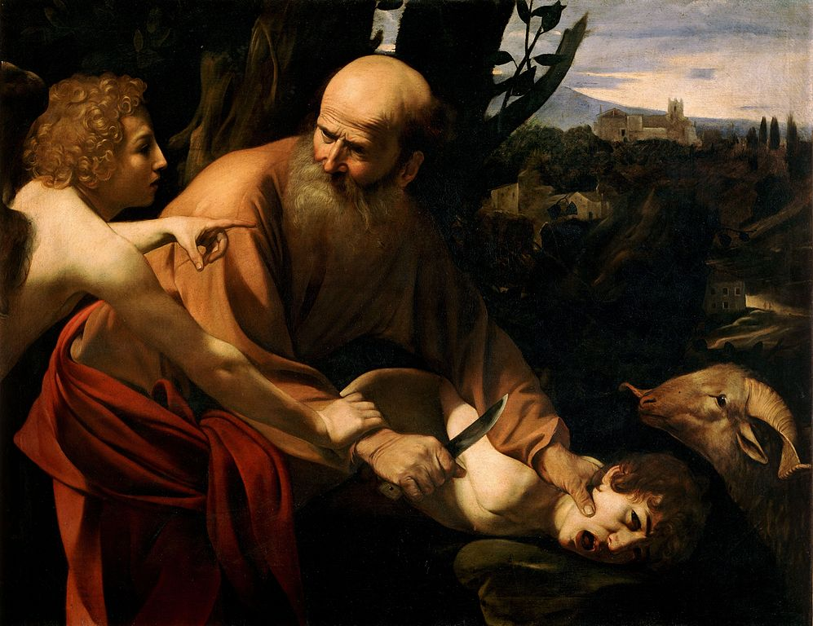
The Sacrifice of Isaac by Michelangelo Merisi da Caravaggio (1572? - 1610) Genesis 22
http://en.wikipedia.org/wiki/File:Sacrifice_of_Isaac-Caravaggio_%28Uffizi%29.jpg

Slide 2
Genesis 22:1
וַיְהִ֗י אַחַר֙ הַדְּבָרִ֣ים הָאֵ֔לֶּה
וְהָ֣אֱלֹהִ֔ים נִסָּ֖ה אֶת־אַבְרָהָ֑ם
וַיֹּ֣אמֶר אֵלָ֔יו
אַבְרָהָ֖ם
וַיֹּ֥אמֶר
הִנֵּֽנִי׃

Slide 3
Genesis 22:1
What is the relationship between these 2 words?
וַיְהִ֗י אַחַר֙ הַדְּבָרִ֣ים הָאֵ֔לֶּה
וְהָ֣אֱלֹהִ֔ים נִסָּ֖ה אֶת־אַבְרָהָ֑ם
וַיֹּ֣אמֶר אֵלָ֔יו
אַבְרָהָ֖ם
וַיֹּ֥אמֶר
הִנֵּֽנִי׃
What is the significance of the article on this word?
How does the syntax of this clause support that significance?
What role does this clause play in the whole narrative?
What genre is this?
What genre is this?
What are the two parts to this word?
What does this signify?
Notes:
Noun and an attributive demonstrative adjective. Agree in gender, number and definite status.
The article on Elohim distinguishes Elohim as the God of Israel rather than the gods of the Canaanites which often demanded child sacrifice. This test does not originate with the Canaanite gods.
The x-qatal syntax fronts ha-elohim. “and it was God who was a tester of Abraham.” Also the choice of qatal could indicate that this is talking about the kind of God Elohim is as opposed to simply describing this particular incident.
This x-qatal is a summary/headline statement for the whole narrative.
Genre 1 = Historical Narrative
Genre 2 = Embedded Direct Speech
In the second line, how does the x-qatal syntax and the article on the subject
In the second line, what two morphological/syntactical features nuance the message of the text in a manner that would likely be sensed by native Hebrew speakers in an Ancient Near eastern context but would likely be missed by English speakers reading an English translation? Please describe each feature and its communicative/theological significance in this text.
ANS
(It’s not the Canaanite god’s doing this, it’s the God of Abraham. The God of Abraham is a tester. It is out of character for him to be asking for child sacrifice.)
The article on Elohim distinguishes Elohim as the God of Israel rather than the gods of the Canaanites which often demanded child sacrifice. This test does not originate with the Canaanite gods.
The x-qatal syntax fonts ha-elohim. “and it was God who was a tester of Abraham.” Also the choice of qatal could indicate that this is talking about the kind of God Elohim is as opposed to simply describing this particular incident.

Slide 4
Genesis 22:2
וַיֹּ֡אמֶר
קַח־נָ֠א אֶת־בִּנְךָ֨
אֶת־יְחִֽידְךָ֤ אֲשֶׁר־אָהַ֙בְתָּ֙
אֶת־יִצְחָ֔ק
וְלֶךְ־לְךָ֔ אֶל־אֶ֖רֶץ הַמֹּרִיָּ֑ה
וְהַעֲלֵ֤הוּ שָׁם֙ לְעֹלָ֔ה
עַ֚ל אַחַ֣ד הֶֽהָרִ֔ים אֲשֶׁ֖ר אֹמַ֥ר אֵלֶֽיךָ׃

Slide 5
Genesis 22:2
How do we know who is speaking here when the subject is not stated? Refer back to verse 1.
וַיֹּ֡אמֶר
קַח־נָ֠א אֶת־בִּנְךָ֨
אֶת־יְחִֽידְךָ֤ אֲשֶׁר־אָהַ֙בְתָּ֙
אֶת־יִצְחָ֔ק
וְלֶךְ־לְךָ֔ אֶל־אֶ֖רֶץ הַמֹּרִיָּ֑ה
וְהַעֲלֵ֤הוּ שָׁם֙ לְעֹלָ֔ה
עַ֚ל אַחַ֣ד הֶֽהָרִ֔ים אֲשֶׁ֖ר אֹמַ֥ר אֵלֶֽיךָ׃
What is the first vowel of this word when it does NOT have a pronominal suffix (see Rocine p 102)?
יָחִיד is an adjective meaning only.
How is the adjective functioning here
(attributive, predicate, substantive)?
Imperative
Or command
What is the function of this qatal?
Why is present tense a good translation option for this particular verb?
How does an “-er” style of translation of this qatal hint at the theology/message of this passage?
What is the direct object of this verb?
Why might this DDO be listed last?
2nd Imperative
3rd Imperative
How do we know this is NOT a qatal? (Cf. with verb directly above.)
Notes:
Dialogue in BH alternates between speakers by default.
In the absolute the first vowel is a tsere.
Substantive (i.e. as a noun)
There is one object (Isaac) described in 3 ways with 3 ‘et’ statements.
Relative past background.
“had” would make it sound like Abraham no longer loves his son. Verbs "that refer to emotional and mental activity usually require present tense translations.“
Abraham is a lover of his son. Is he also a lover of his God? Elohim is a tester of our love for him.
A qatal would have a qamets under the aleph. This may look a bit like a participle but it is 1cs yiqtol.

Slide 6
Genesis 22:3
וַיַּשְׁכֵּ֨ם אַבְרָהָ֜ם בַּבֹּ֗קֶר
וַֽיַּחֲבֹשׁ֙ אֶת־חֲמֹר֔וֹ
וַיִּקַּ֞ח אֶת־שְׁנֵ֤י נְעָרָיו֙ אִתּ֔וֹ וְאֵ֖ת יִצְחָ֣ק בְּנ֑וֹ
וַיְבַקַּע֙ עֲצֵ֣י עֹלָ֔ה
וַיָּ֣קָם
וַיֵּ֔לֶךְ אֶל־הַמָּק֖וֹם אֲשֶׁר־אָֽמַר־ל֥וֹ הָאֱלֹהִֽים׃
Notes:
Using only the mainline verbs in this verse, list the actions that Abraham does in this section of the story.
ANS
He got up early, he saddled (his donkey), he took (his two servants), he split (wood), he arose, he went
At this point in the story does Abraham know where he is going? Defend your answer.
ANS
Yes, in the last line of verse 3 the qatal is relative past background.

Slide 7
Genesis 22:4
בַּיּ֣וֹם הַשְּׁלִישִׁ֗י
וַיִּשָּׂ֨א אַבְרָהָ֧ם אֶת־עֵינָ֛יו
וַיַּ֥רְא אֶת־הַמָּק֖וֹם מֵרָחֹֽק׃

Slide 8
Genesis 22:5
וַיֹּ֨אמֶר אַבְרָהָ֜ם אֶל־נְעָרָ֗יו
שְׁבוּ־לָכֶ֥ם פֹּה֙ עִֽם־הַחֲמ֔וֹר
וַאֲנִ֣י וְהַנַּ֔עַר נֵלְכָ֖ה עַד־כֹּ֑ה
וְנִֽשְׁתַּחֲוֶ֖ה
וְנָשׁ֥וּבָה אֲלֵיכֶֽם׃
Notes:
Note: the first verb in the direct speech is a command - the masculine plural imperative of ישׁב.
In this verse, Abraham contrasts the actions of 2 groups of people. One group will do one thing and the other three things. Indicate what the groups are and what they will each do.
ANS
Abraham’s servants: stay with the donkey
Abraham and Isaac: go up there; worship, return to the servants

Slide 9
Genesis 22:6
וַיִּקַּ֨ח אַבְרָהָ֜ם אֶת־עֲצֵ֣י הָעֹלָ֗ה
וַיָּ֙שֶׂם֙ עַל־יִצְחָ֣ק בְּנ֔וֹ
וַיִּקַּ֣ח בְּיָד֔וֹ אֶת־הָאֵ֖שׁ וְאֶת־הַֽמַּאֲכֶ֑לֶת
וַיֵּלְכ֥וּ שְׁנֵיהֶ֖ם יַחְדָּֽו׃

Slide 10
Genesis 22:7
וַיֹּ֨אמֶר יִצְחָ֜ק אֶל־אַבְרָהָ֤ם אָבִיו֙
וַיֹּ֣אמֶר
אָבִ֔י
וַיֹּ֖אמֶר
הִנֶּ֣נִּֽי בְנִ֑י
וַיֹּ֗אמֶר
הִנֵּ֤ה הָאֵשׁ֙ וְהָ֣עֵצִ֔ים
וְאַיֵּ֥ה הַשֶּׂ֖ה לְעֹלָֽה׃

Slide 11
Genesis 22:8
וַיֹּ֙אמֶר֙ אַבְרָהָ֔ם
אֱלֹהִ֞ים יִרְאֶה־לּ֥וֹ הַשֶּׂ֛ה לְעֹלָ֖ה בְּנִ֑י
וַיֵּלְכ֥וּ שְׁנֵיהֶ֖ם יַחְדָּֽו׃

Slide 12
Genesis 22:9
וַיָּבֹ֗אוּ אֶֽל־הַמָּקוֹם֮ אֲשֶׁ֣ר אָֽמַר־ל֣וֹ הָאֱלֹהִים֒
וַיִּ֨בֶן שָׁ֤ם אַבְרָהָם֙ אֶת־הַמִּזְבֵּ֔חַ
וַֽיַּעֲרֹ֖ךְ אֶת־הָעֵצִ֑ים
וַֽיַּעֲקֹד֙ אֶת־יִצְחָ֣ק בְּנ֔וֹ
וַיָּ֤שֶׂם אֹתוֹ֙ עַל־הַמִּזְבֵּ֔חַ מִמַּ֖עַל לָעֵצִֽים׃

Slide 13
Genesis 22:10
וַיִּשְׁלַ֤ח אַבְרָהָם֙ אֶת־יָד֔וֹ
וַיִּקַּ֖ח אֶת־הַֽמַּאֲכֶ֑לֶת לִשְׁחֹ֖ט אֶת־בְּנֽוֹ׃

Slide 14
Genesis 22:11
וַיִּקְרָ֨א אֵלָ֜יו מַלְאַ֤ךְ יְהוָה֙ מִן־הַשָּׁמַ֔יִם
וַיֹּ֖אמֶר
אַבְרָהָ֣ם ׀ אַבְרָהָ֑ם
וַיֹּ֖אמֶר
הִנֵּֽנִי׃

Slide 15
Genesis 22:12
וַיֹּ֗אמֶר
אַל־תִּשְׁלַ֤ח יָֽדְךָ֙ אֶל־הַנַּ֔עַר
וְאַל־תַּ֥עַשׂ ל֖וֹ מְא֑וּמָּה
כִּ֣י ׀ עַתָּ֣ה יָדַ֗עְתִּי
כִּֽי־יְרֵ֤א אֱלֹהִים֙ אַ֔תָּה
וְלֹ֥א חָשַׂ֛כְתָּ אֶת־בִּנְךָ֥
אֶת־יְחִידְךָ֖ מִמֶּֽנִּי׃

Slide 16
Genesis 22:13
וַיִּשָּׂ֨א אַבְרָהָ֜ם אֶת־עֵינָ֗יו
וַיַּרְא֙ וְהִנֵּה־אַ֔יִל אַחַ֕ר נֶאֱחַ֥ז בַּסְּבַ֖ךְ בְּקַרְנָ֑יו
וַיֵּ֤לֶךְ אַבְרָהָם֙
וַיִּקַּ֣ח אֶת־הָאַ֔יִל
וַיַּעֲלֵ֥הוּ לְעֹלָ֖ה תַּ֥חַת בְּנֽוֹ׃

Slide 17
Genesis 22:14
וַיִּקְרָ֧א אַבְרָהָ֛ם שֵֽׁם־הַמָּק֥וֹם הַה֖וּא
יְהוָ֣ה ׀ יִרְאֶ֑ה אֲשֶׁר֙ יֵאָמֵ֣ר הַיּ֔וֹם
בְּהַ֥ר יְהוָ֖ה יֵרָאֶֽה׃

Slide 18
Genesis 22:15
וַיִּקְרָ֛א מַלְאַ֥ךְ יְהוָ֖ה אֶל־אַבְרָהָ֑ם שֵׁנִ֖ית
מִן־הַשָּׁמָֽיִם׃

Slide 19
Genesis 22:16
וַיֹּ֕אמֶר
בִּ֥י נִשְׁבַּ֖עְתִּי נְאֻם־יְהוָ֑ה
כִּ֗י יַ֚עַן אֲשֶׁ֤ר עָשִׂ֙יתָ֙ אֶת־הַדָּבָ֣ר הַזֶּ֔ה
וְלֹ֥א חָשַׂ֖כְתָּ אֶת־בִּנְךָ֥ אֶת־יְחִידֶֽךָ׃

Slide 20
Genesis 22:17
כִּֽי־בָרֵ֣ךְ אֲבָרֶכְךָ֗
וְהַרְבָּ֨ה אַרְבֶּ֤ה אֶֽת־זַרְעֲךָ֙
כְּכוֹכְבֵ֣י הַשָּׁמַ֔יִם
וְכַח֕וֹל אֲשֶׁ֖ר עַל־שְׂפַ֣ת הַיָּ֑ם
וְיִרַ֣שׁ זַרְעֲךָ֔ אֵ֖ת שַׁ֥עַר אֹיְבָֽיו׃

Slide 21
Genesis 22:18
וְהִתְבָּרֲכ֣וּ בְזַרְעֲךָ֔ כֹּ֖ל גּוֹיֵ֣י הָאָ֑רֶץ
עֵ֕קֶב אֲשֶׁ֥ר שָׁמַ֖עְתָּ בְּקֹלִֽי׃

Slide 22
Genesis 22:19
וַיָּ֤שָׁב אַבְרָהָם֙ אֶל־נְעָרָ֔יו
וַיָּקֻ֛מוּ
וַיֵּלְכ֥וּ יַחְדָּ֖ו אֶל־בְּאֵ֣ר שָׁ֑בַע
וַיֵּ֥שֶׁב אַבְרָהָ֖ם בִּבְאֵ֥ר שָֽׁבַע׃

Slide 23
Genesis 22:20
וַיְהִ֗י אַחֲרֵי֙ הַדְּבָרִ֣ים הָאֵ֔לֶּה
וַיֻּגַּ֥ד לְאַבְרָהָ֖ם לֵאמֹ֑ר
הִ֠נֵּה יָלְדָ֨ה מִלְכָּ֥ה גַם־הִ֛וא
בָּנִ֖ים לְנָח֥וֹר אָחִֽיךָ׃

Slide 24
Genesis 22:21
אֶת־ע֥וּץ בְּכֹר֖וֹ
וְאֶת־בּ֣וּז אָחִ֑יו
וְאֶת־קְמוּאֵ֖ל אֲבִ֥י אֲרָֽם׃

Slide 25
Genesis 22:22
וְאֶת־כֶּ֣שֶׂד
וְאֶת־חֲז֔וֹ
וְאֶת־פִּלְדָּ֖שׁ
וְאֶת־יִדְלָ֑ף
וְאֵ֖ת בְּתוּאֵֽל׃

Slide 26
Genesis 22:23
וּבְתוּאֵ֖ל יָלַ֣ד אֶת־רִבְקָ֑ה
שְׁמֹנָ֥ה אֵ֙לֶּה֙ יָלְדָ֣ה מִלְכָּ֔ה
לְנָח֖וֹר אֲחִ֥י אַבְרָהָֽם׃

Slide 27
Genesis 22:24
וּפִֽילַגְשׁ֖וֹ
וּשְׁמָ֣הּ רְאוּמָ֑ה
וַתֵּ֤לֶד גַּם־הִוא֙ אֶת־טֶ֣בַח
וְאֶת־גַּ֔חַם
וְאֶת־תַּ֖חַשׁ
וְאֶֽת־מַעֲכָֽה׃

