Slide 1
Rocine Lesson 46
וַיָּסֹבּוּ אֶת־הָעִיר כַּמִּשְׁפָּט הַזֶּה שֶׁ֫בַע פְּעָמִים רַק בַּיּוֹם הַהוּא סָבְבוּ אֶת־הָעִיר שֶׁ֫בַע פְּעָמִים
Joshua 6:15

Slide 2
MODULE SIX
Geminates (e.g. סבב, חלל, הלל)
Numbers
Discourse
using a qatal to set the time of a scene
modal yiqtol
marking peak in a discourse

Slide 3
Lesson 46 - Goals
Identify and read
geminate roots

Slide 4
What we already know
וַיָּסֹבּוּ אֶת־הָעִיר כַּמִּשְׁפָּט הַזֶּה שֶׁ֫בַע פְּעָמִים רַק בַּיּוֹם הַהוּא סָבְבוּ אֶת־הָעִיר שֶׁ֫בַע פְּעָמִים
Identify
the Wayyiqtols
the Qatals

Slide 5
What we already know
וַיָּסֹבּוּ אֶת־הָעִיר כַּמִּשְׁפָּט הַזֶּה שֶׁ֫בַע פְּעָמִים רַק בַּיּוֹם הַהוּא סָבְבוּ אֶת־הָעִיר שֶׁ֫בַע פְּעָמִים
Identify
the Wayyiqtols
the Qatals

Slide 6
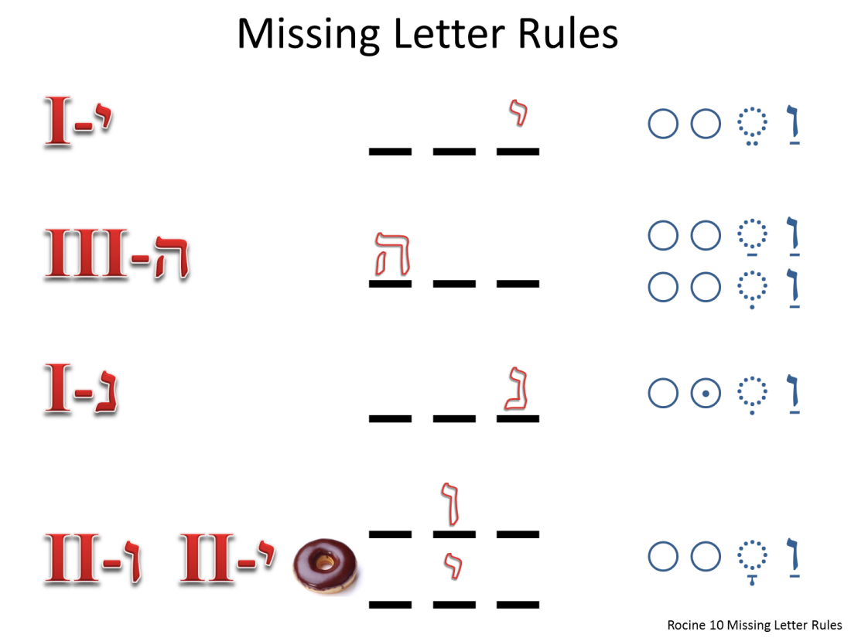
What we already know
וַיָּסֹבּוּ אֶת־הָעִיר כַּמִּשְׁפָּט הַזֶּה שֶׁ֫בַע פְּעָמִים רַק בַּיּוֹם הַהוּא סָבְבוּ אֶת־הָעִיר שֶׁ֫בַע פְּעָמִים
What would the Missing Letter Rules predict for the first verb?

Slide 7
What we already know
וַיָּסֹבּוּ אֶת־הָעִיר כַּמִּשְׁפָּט הַזֶּה שֶׁ֫בַע פְּעָמִים רַק בַּיּוֹם הַהוּא סָבְבוּ אֶת־הָעִיר שֶׁ֫בַע פְּעָמִים
What would the Missing Letter Rules predict for the first verb?
The qamets prefix would point to a Hollow verb.
Though the dagesh forte in the bet hints that something else may be going on here, we will find that there is considerable overlap between Hollow verbs and Geminate verbs.

Slide 8
Qal yiqtol and wayyiqtol of geminates
וַיָּסֹבּוּ אֶת־הָעִיר כַּמִּשְׁפָּט הַזֶּה שֶׁ֫בַע פְּעָמִים רַק בַּיּוֹם הַהוּא סָבְבוּ אֶת־הָעִיר שֶׁ֫בַע פְּעָמִים
DEFINITION:
Roots whose 2nd and 3rd letters are the same are called geminates.
They conjugate erratically,
often losing one of the twin root letters
and showing the nikkud of a hollow verb.

Slide 9
Qal yiqtol and wayyiqtol of geminates
וַיָּסֹבּוּ אֶת־הָעִיר כַּמִּשְׁפָּט הַזֶּה שֶׁ֫בַע פְּעָמִים רַק בַּיּוֹם הַהוּא סָבְבוּ אֶת־הָעִיר שֶׁ֫בַע פְּעָמִים
Let’s translate the first phrase.

Slide 10
Qal yiqtol and wayyiqtol of geminates
וַיָּסֹבּוּ אֶת־הָעִיר כַּמִּשְׁפָּט הַזֶּה שֶׁ֫בַע פְּעָמִים רַק בַּיּוֹם הַהוּא סָבְבוּ אֶת־הָעִיר שֶׁ֫בַע פְּעָמִים
Let’s translate the first phrase.
And they surrounded the city

Slide 11
Qal yiqtol and wayyiqtol of geminates
וַיָּסֹבּוּ אֶת־הָעִיר כַּמִּשְׁפָּט הַזֶּה שֶׁ֫בַע פְּעָמִים רַק בַּיּוֹם הַהוּא סָבְבוּ אֶת־הָעִיר שֶׁ֫בַע פְּעָמִים
Now, let’s try translating the whole verse.
מִשְׁפָּט can mean manner, custom as well as judgment.
What clause boundary options do we have here in this verse?

Slide 12
Qal yiqtol and wayyiqtol of geminates
וַיָּסֹבּוּ אֶת־הָעִיר כַּמִּשְׁפָּט הַזֶּה שֶׁ֫בַע פְּעָמִים רַק בַּיּוֹם הַהוּא סָבְבוּ אֶת־הָעִיר שֶׁ֫בַע פְּעָמִים
?
?
?
To determine clause boundaries it is helpful to identify the verbs and their function.

Slide 13
Qal yiqtol and wayyiqtol of geminates
וַיָּסֹבּוּ אֶת־הָעִיר כַּמִּשְׁפָּט הַזֶּה שֶׁ֫בַע פְּעָמִים רַק בַּיּוֹם הַהוּא סָבְבוּ אֶת־הָעִיר שֶׁ֫בַע פְּעָמִים
?
?
?
The wayyiqtol is straight forward. It’s the mainline for historical narrative and it starts a clause. But what options do we have for qatal? Does qatal start a clause?

Slide 14
Qal yiqtol and wayyiqtol of geminates
וַיָּסֹבּוּ אֶת־הָעִיר כַּמִּשְׁפָּט הַזֶּה שֶׁ֫בַע פְּעָמִים רַק בַּיּוֹם הַהוּא סָבְבוּ אֶת־הָעִיר שֶׁ֫בַע פְּעָמִים
?
?
?
The wayyiqtol is straight forward. It’s the mainline for historical narrative and it starts a clause. But what options do we have for qatal? Does qatal start a clause?
Weqatal
Qatal in dependent clause
X-Qatal
Qatal at the start of a clause can open an Historical Narrative
“A clause-initial qatal often opens Historical Narrative that is within direct speech.” (Rocine 26.2)

Slide 15
Qal yiqtol and wayyiqtol of geminates
וַיָּסֹבּוּ אֶת־הָעִיר כַּמִּשְׁפָּט הַזֶּה שֶׁ֫בַע פְּעָמִים רַק בַּיּוֹם הַהוּא סָבְבוּ אֶת־הָעִיר שֶׁ֫בַע פְּעָמִים
?
?
?
Masoretic cantillation (טְעָמִים tea'mim) is also very helpful for determining clause boundaries.
Can you see where the Masoretes place the clause boundary?
וַיָּסֹ֧בּוּ אֶת־הָעִ֛יר כַּמִּשְׁפָּ֥ט הַזֶּ֖ה שֶׁ֣בַע פְּעָמִ֑ים רַ֚ק בַּיּ֣וֹם הַה֔וּא סָבְב֥וּ אֶת־הָעִ֖יר שֶׁ֥בַע פְּעָמִֽים׃
See “What are the Accents? (Tea'mim - Cantillations) | Biblical Hebrew Q&A with eTeacherBiblical” on YouTube for a nice introduction to the topic. https://www.youtube.com/watch?v=GMzawdQMb-E

Slide 16
Qal yiqtol and wayyiqtol of geminates
וַיָּסֹ֧בּוּ אֶת־הָעִ֛יר כַּמִּשְׁפָּ֥ט הַזֶּ֖ה שֶׁ֣בַע פְּעָמִ֑ים רַ֚ק בַּיּ֣וֹם הַה֔וּא סָבְב֥וּ אֶת־הָעִ֖יר שֶׁ֥בַע פְּעָמִֽים׃
Parse סָבְב֥וּ
Root | Stem | Form | PGN | Function | Root meaning

Slide 17
Qal yiqtol and wayyiqtol of geminates
וַיָּסֹ֧בּוּ אֶת־הָעִ֛יר כַּמִּשְׁפָּ֥ט הַזֶּ֖ה שֶׁ֣בַע פְּעָמִ֑ים רַ֚ק בַּיּ֣וֹם הַה֔וּא סָבְב֥וּ אֶת־הָעִ֖יר שֶׁ֥בַע פְּעָמִֽים׃
Parse סָבְב֥וּ
Root | Stem | Form | PGN | Function | Root meaning
סבב | Qal | Qatal | 3cp | X-Qatal topicalization | To surround
They surrounded the city according to this manner seven times.
It was only on that day that they surrounded the city seven times.

Slide 18
Geminate morphology
וַיָּסֹ֧בּוּ אֶת־הָעִ֛יר כַּמִּשְׁפָּ֥ט הַזֶּ֖ה שֶׁ֣בַע פְּעָמִ֑ים רַ֚ק בַּיּ֣וֹם הַה֔וּא סָבְב֥וּ אֶת־הָעִ֖יר שֶׁ֥בַע פְּעָמִֽים׃
Geminate morphology is a bit erratic, but there are patterns as can be seen in the verb tables.
For a detailed discussion of Geminate verbs see Animated Hebrew lecture 39.

Slide 19
Geminate morphology
וַיָּסֹ֧בּוּ אֶת־הָעִ֛יר כַּמִּשְׁפָּ֥ט הַזֶּ֖ה שֶׁ֣בַע פְּעָמִ֑ים רַ֚ק בַּיּ֣וֹם הַה֔וּא סָבְב֥וּ אֶת־הָעִ֖יר שֶׁ֥בַע פְּעָמִֽים׃
Geminate morphology is a bit erratic, but there are patterns as can be seen in the verb tables.
For a detailed discussion of Geminate verbs see Animated Hebrew lecture 39.
“The best strategy for dealing with geminates is to know the commonly used roots and keep them in mind when you only see two root letters of a verb.”
(Rocine 46.2b., p. 256)

Slide 20
Common Geminates
סבב | Surround | תמם | Be complete | מדד | Measure
רבב | Become great | שׁמם | Be desolate | שׁדד | Lay waste
 |  | חמם | Become warm
הלל | Praise | המם | Make a noise | חנן | Show favour
חלל | Profane Begin |  |  | רנן | Give a piercing cry
פלל | Pray
 |  |  |  | צרר | Be hostile
רעע | Be evil |  |  | ארר | Curse

