Slide 1

Rocine Lesson 42
וָאֶתְנַפַּל לִפְנֵי יְהוָה אֵת אַרְבָּעִים הַיּוֹם וְאֶת־אַרְבָּעִים הַלַּ֫יְלָה אֲשֶׁר הִתְנַפָּ֫לְתִּי
Deuteronomy 9:25

Slide 2
Goals
Identify and read
verbs in the Hitpael stem

Slide 3
What we already know
וָאֶתְנַפַּל לִפְנֵי יְהוָה אֵת אַרְבָּעִים הַיּוֹם וְאֶת־אַרְבָּעִים הַלַּ֫יְלָה אֲשֶׁר הִתְנַפָּ֫לְתִּי
Identify the wayyiqtol and the qatal in this verse.

Slide 4
What we already know
Wayyiqtol Waw
Prefix
וָאֶתְנַפַּל לִפְנֵי יְהוָה אֵת אַרְבָּעִים הַיּוֹם וְאֶת־אַרְבָּעִים הַלַּ֫יְלָה אֲשֶׁר הִתְנַפָּ֫לְתִּי
Affix
Identify the wayyiqtol and the qatal in this verse.

Slide 5
The signs of the Hitpael stem
וָאֶתְנַפַּל לִפְנֵי יְהוָה אֵת אַרְבָּעִים הַיּוֹם וְאֶת־אַרְבָּעִים הַלַּ֫יְלָה אֲשֶׁר הִתְנַפָּ֫לְתִּי
The signs of the Hithpael are very clear.
RULE: The signs of the Hitpael stem are
a pre-formed something-tav unit [ת___]
and a dagesh forte in the middle root letter.

Slide 6
The signs of the Hitpael stem
וָאֶתְנַפַּל לִפְנֵי יְהוָה אֵת אַרְבָּעִים הַיּוֹם וְאֶת־אַרְבָּעִים הַלַּ֫יְלָה אֲשֶׁר הִתְנַפָּ֫לְתִּי
The signs of the Hithpael are very clear.
RULE: The signs of the Hitpael stem are
a pre-formed something-tav unit [ת___]
  הִת
  נִת אֶת תִּת יִת
  מִת
and a dagesh forte in the middle root letter.

Slide 7
The signs of the Hitpael stem
וָאֶתְנַפַּל לִפְנֵי יְהוָה אֵת אַרְבָּעִים הַיּוֹם וְאֶת־אַרְבָּעִים הַלַּ֫יְלָה אֲשֶׁר הִתְנַפָּ֫לְתִּי
The signs of the Hithpael are very clear.
RULE: The signs of the Hitpael stem are
a pre-formed something-tav unit [ת___]
  הִת
  נִת אֶת תִּת יִת
  מִת
and a dagesh forte in the middle root letter.
Can you guess which pre-formed units go on which forms?

Slide 8
The signs of the Hitpael stem
וָאֶתְנַפַּל לִפְנֵי יְהוָה אֵת אַרְבָּעִים הַיּוֹם וְאֶת־אַרְבָּעִים הַלַּ֫יְלָה אֲשֶׁר הִתְנַפָּ֫לְתִּי
The signs of the Hithpael are very clear.
RULE: The signs of the Hitpael stem are
a pre-formed something-tav unit [ת___]
  הִת
  נִת אֶת תִּת יִת
  מִת
and a dagesh forte in the middle root letter.
Qatal, Imperatives, Infinitives (inf and abs)
Yiqtol/Wayyiqtol (also Jussive/Cohortative)
Participle

Slide 9
The signs of the Hitpael stem
וָאֶתְנַפַּל לִפְנֵי יְהוָה אֵת אַרְבָּעִים הַיּוֹם וְאֶת־אַרְבָּעִים הַלַּ֫יְלָה אֲשֶׁר הִתְנַפָּ֫לְתִּי
Let’s part the verbs.
Root | Stem | Form | PGN | Function | Root meaning
Root | Stem | Form | PGN | Function | Root meaning

Slide 10
The signs of the Hitpael stem
וָאֶתְנַפַּל לִפְנֵי יְהוָה אֵת אַרְבָּעִים הַיּוֹם וְאֶת־אַרְבָּעִים הַלַּ֫יְלָה אֲשֶׁר הִתְנַפָּ֫לְתִּי
Let’s part the verbs.
Root | Stem | Form | PGN | Function | Root meaning
נפל | Hithpael | Wayyiqtol | 1cs | Historical Narrative Mainline | To fall
Root | Stem | Form | PGN | Function | Root meaning

Slide 11
The signs of the Hitpael stem
וָאֶתְנַפַּל לִפְנֵי יְהוָה אֵת אַרְבָּעִים הַיּוֹם וְאֶת־אַרְבָּעִים הַלַּ֫יְלָה אֲשֶׁר הִתְנַפָּ֫לְתִּי
Let’s part the verbs.
Root | Stem | Form | PGN | Function | Root meaning
נפל | Hithpael | Wayyiqtol | 1cs | Historical Narrative Mainline | To fall
Root | Stem | Form | PGN | Function | Root meaning
נפל | Hithpael | Qatal | 1cs | Qatal in dep. Clause = Rel. past background | To fall

Slide 12
The meaning of the Hitpael stem
וָאֶתְנַפַּל לִפְנֵי יְהוָה אֵת אַרְבָּעִים הַיּוֹם וְאֶת־אַרְבָּעִים הַלַּ֫יְלָה אֲשֶׁר הִתְנַפָּ֫לְתִּי
What does נפל mean in the Qal?

Slide 13
The meaning of the Hitpael stem
וָאֶתְנַפַּל לִפְנֵי יְהוָה אֵת אַרְבָּעִים הַיּוֹם וְאֶת־אַרְבָּעִים הַלַּ֫יְלָה אֲשֶׁר הִתְנַפָּ֫לְתִּי
What does נפל mean in the Qal?
To fall

Slide 14
The meaning of the Hitpael stem
וָאֶתְנַפַּל לִפְנֵי יְהוָה אֵת אַרְבָּעִים הַיּוֹם וְאֶת־אַרְבָּעִים הַלַּ֫יְלָה אֲשֶׁר הִתְנַפָּ֫לְתִּי
What does נפל mean in the Qal?
In the Hithpael נפל means
to prostrate oneself
to throw oneself upon.
To fall

Slide 15
The meaning of the Hitpael stem
וָאֶתְנַפַּל לִפְנֵי יְהוָה אֵת אַרְבָּעִים הַיּוֹם וְאֶת־אַרְבָּעִים הַלַּ֫יְלָה אֲשֶׁר הִתְנַפָּ֫לְתִּי
What does נפל mean in the Qal?
In the Hithpael נפל means
to prostrate oneself
to throw oneself upon.
Like the Niphal, the Hithpael can give a root a reflexive meaning. Sometimes also a frequentive or repetitive meaning.
To fall

Slide 16
The meaning of the Hitpael stem
וָאֶתְנַפַּל לִפְנֵי יְהוָה אֵת אַרְבָּעִים הַיּוֹם וְאֶת־אַרְבָּעִים הַלַּ֫יְלָה אֲשֶׁר הִתְנַפָּ֫לְתִּי
Root | Qal | Hithpael
ראה | See | Look at one another
הלך | Walk, go | Go to and fro
לקח | Take | Take hold of oneself, Flash about (said of lightening)
חזק | Be strong | Strengthen oneself
נשׂא | Lift | Exalt oneself
קדשׁ | Be holy | Display or celebrate one’s holiness

Slide 17
The meaning of the Hitpael stem
וָאֶתְנַפַּל לִפְנֵי יְהוָה אֵת אַרְבָּעִים הַיּוֹם וְאֶת־אַרְבָּעִים הַלַּ֫יְלָה אֲשֶׁר הִתְנַפָּ֫לְתִּי
Genesis 42:1
וַיַּ֣רְא יַעֲקֹ֔ב כִּ֥י יֶשׁ־שֶׁ֖בֶר בְּמִצְרָ֑יִם
וַיֹּ֤אמֶר יַעֲקֹב֙ לְבָנָ֔יו
לָ֖מָּה תִּתְרָאֽוּ׃
When Jacob saw that there was grain in Egypt,
he said to his sons,
"Why do you look at one another?"

Slide 18
The meaning of the Hitpael stem
וָאֶתְנַפַּל לִפְנֵי יְהוָה אֵת אַרְבָּעִים הַיּוֹם וְאֶת־אַרְבָּעִים הַלַּ֫יְלָה אֲשֶׁר הִתְנַפָּ֫לְתִּי
Genesis 5:22,24
וַיִּתְהַלֵּ֙ךְ חֲנ֜וֹךְ אֶת־הָֽאֱלֹהִ֗ים אַֽחֲרֵי֙ הוֹלִיד֣וֹ אֶת־מְתוּשֶׁ֔לַח שְׁלֹ֥שׁ מֵא֖וֹת שָׁנָ֑ה וַיּ֥וֹלֶד בָּנִ֖ים וּבָנֽוֹת׃
וַיִּתְהַלֵּ֥ךְ חֲנ֖וֹךְ אֶת־הָֽאֱלֹהִ֑ים וְאֵינֶ֕נּוּ כִּֽי־לָקַ֥ח אֹת֖וֹ אֱלֹהִֽים׃
Enoch walked with God after he fathered Methuselah 300 years and had other sons and daughters.
Enoch walked with God, and he was not, for God took him.
Hiph Inf. Const.
+ 3ms sfx

Slide 19
The meaning of the Hitpael stem
וָאֶתְנַפַּל לִפְנֵי יְהוָה אֵת אַרְבָּעִים הַיּוֹם וְאֶת־אַרְבָּעִים הַלַּ֫יְלָה אֲשֶׁר הִתְנַפָּ֫לְתִּי
Exodus 9:24
וַיְהִ֣י בָרָ֔ד וְאֵ֕שׁ מִתְלַקַּ֖חַת בְּת֣וֹךְ הַבָּרָ֑ד כָּבֵ֣ד מְאֹ֔ד
אֲ֠שֶׁר לֹֽא־הָיָ֤ה כָמֹ֙הוּ֙ בְּכָל־אֶ֣רֶץ מִצְרַ֔יִם
מֵאָ֖ז הָיְתָ֥ה לְגֽוֹי׃
There was hail and fire flashing continually in the midst of the hail, very heavy,
such was not like it in all the land of Egypt
Since [from when] it became a nation.
hail

Slide 20
The particleאת as a marker of the accusative case
וָאֶתְנַפַּל לִפְנֵי יְהוָה אֵת אַרְבָּעִים הַיּוֹם וְאֶת־אַרְבָּעִים הַלַּ֫יְלָה אֲשֶׁר הִתְנַפָּ֫לְתִּי
So far we’ve seen 2 uses for את
With
DDO (Definite Direct Object marker)
What does it appear to do in our lesson verse?

Slide 21
The particleאת as a marker of the accusative case
וָאֶתְנַפַּל לִפְנֵי יְהוָה אֵת אַרְבָּעִים הַיּוֹם וְאֶת־אַרְבָּעִים הַלַּ֫יְלָה אֲשֶׁר הִתְנַפָּ֫לְתִּי
So far we’ve seen 2 uses for את
With
DDO (Definite Direct Object marker)
What does it appear to do in our lesson verse?
It sets apart the words which tell for how long the speaker prostrated himself.
This is called an Adverbial Accusative.

Slide 22
The particleאת as a marker of the accusative case
וָאֶתְנַפַּל לִפְנֵי יְהוָה אֵת אַרְבָּעִים הַיּוֹם וְאֶת־אַרְבָּעִים הַלַּ֫יְלָה אֲשֶׁר הִתְנַפָּ֫לְתִּי
Both Adverbs and Direct Objects are in the Accusative case.
Biblical Hebrew does not mark the accusative case morphologically.
  Greek, Latin, German, Russian do
  English, French, Hebrew don’t (or very little)

Slide 23
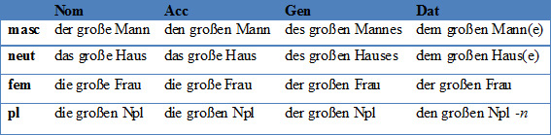
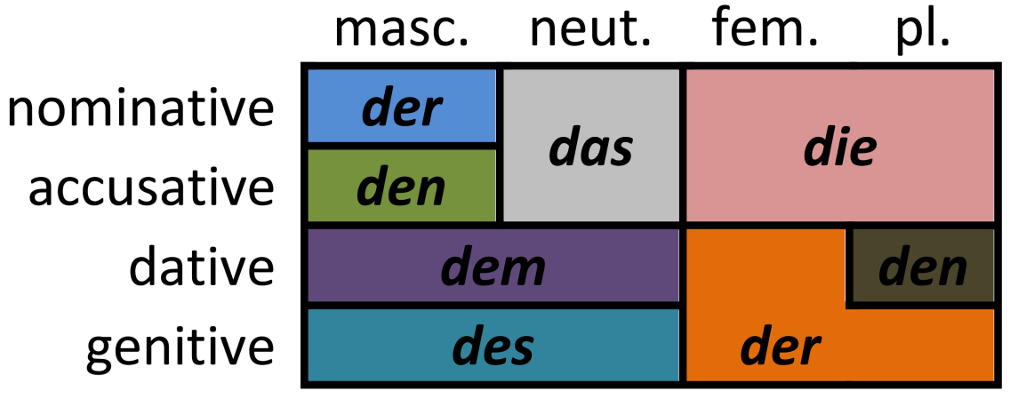
The particleאת as a marker of the accusative case
וָאֶתְנַפַּל לִפְנֵי יְהוָה אֵת אַרְבָּעִים הַיּוֹם וְאֶת־אַרְבָּעִים הַלַּ֫יְלָה אֲשֶׁר הִתְנַפָּ֫לְתִּי
German Cases

Slide 24
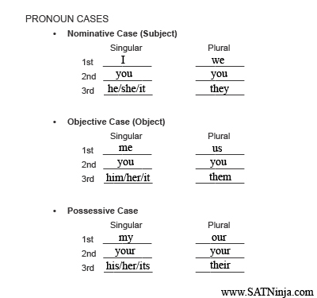
The particleאת as a marker of the accusative case
וָאֶתְנַפַּל לִפְנֵי יְהוָה אֵת אַרְבָּעִים הַיּוֹם וְאֶת־אַרְבָּעִים הַלַּ֫יְלָה אֲשֶׁר הִתְנַפָּ֫לְתִּי
English Cases
Also called accusative

Slide 25
The particleאת as a marker of the accusative case
וָאֶתְנַפַּל לִפְנֵי יְהוָה אֵת אַרְבָּעִים הַיּוֹם וְאֶת־אַרְבָּעִים הַלַּ֫יְלָה אֲשֶׁר הִתְנַפָּ֫לְתִּי
Accusative
Means more than just Direct Objects
Def: “that which modifies the verb”
  Hence DO or adverbs

Slide 26
The particleאת as a marker of the accusative case
וָאֶתְנַפַּל לִפְנֵי יְהוָה אֵת אַרְבָּעִים הַיּוֹם וְאֶת־אַרְבָּעִים הַלַּ֫יְלָה אֲשֶׁר הִתְנַפָּ֫לְתִּי
Accusative
Means more than just Direct Objects
Def: “that which modifies the verb”
  Hence DO or adverbs
In Hebrew, these accusatives (adverbs or DO) can be marked by את IF they are DEFINITE.
Both accusatives can exist WITHOUT את
when they are INDEFINITE.

Slide 27
The particleאת as a marker of the accusative case
וָאֶתְנַפַּל לִפְנֵי יְהוָה אֵת אַרְבָּעִים הַיּוֹם וְאֶת־אַרְבָּעִים הַלַּ֫יְלָה אֲשֶׁר הִתְנַפָּ֫לְתִּי
Examples of Accusatives (Direct Objects and Adverbial Accusatives of …)
I prostrated myself before YHWH [for] 40 days and 40 nights [Adverbial Accusative of TIME; Definite] | Deut 9:25 | Lesson verse above | 1
He divided [his troops] against them [in the] night [Adverbial Accusative of TIME; Indefinite, i.e. no את] | Genesis 14:15 | וַיֵּחָלֵ֙ק עֲלֵיהֶ֧ם׀ לַ֛יְלָה | 2
The woman was taken [to] house of Pharaoh [Adverbial Accusative of PLACE; Indefinite, i.e. no את] | Genesis 12:15 | וַתֻּקַּ֥ח הָאִשָּׁ֖ה בֵּ֥ית פַּרְעֹֽה׃ | 3
The land was filled [with] water [Adverbial Accusative of MATERIAL; Definite] | 2 Kings 3:20 | וַתִּמָּלֵ֥א הָאָ֖רֶץ אֶת־הַמָּֽיִם׃ | 4
And YHWH God formed the man [using] dust from the ground [the man = DIRECT OBJECT; Definite] [dust from the ground = Adverbial Accusative of MATERIAL; Indefinite, i.e. no את] | Genesis 2:7 | וַיִּיצֶר֩ יְהוָ֙ה אֱלֹהִ֜ים אֶת־הָֽאָדָ֗ם עָפָר֙ מִן־הָ֣אֲדָמָ֔ה | 5

Slide 28
The particleאת as a marker of the accusative case
וָאֶתְנַפַּל לִפְנֵי יְהוָה אֵת אַרְבָּעִים הַיּוֹם וְאֶת־אַרְבָּעִים הַלַּ֫יְלָה אֲשֶׁר הִתְנַפָּ֫לְתִּי
את can sometimes also mark a subject
This is NOT an accusative. It would be nominative.
A bit of a “mystery” (Rocine p. 238)

