Slide 1

Rocine Lesson 18
וַיֹּ֫אמֶר חֹתֵן מֹשֶׁה אֵלָיו לֹא־טוֹב הַדָּבָר אֲשֶׁר אַתָּה עֹשֶׂה׃
Exodus 18:17

Slide 2
Goals
Identify and read
adjectives
independent subject pronouns
the most common irregular nouns

Slide 3
What you already know
וַיֹּ֫אמֶר חֹתֵן מֹשֶׁה אֵלָיו לֹא־טוֹב הַדָּבָר אֲשֶׁר אַתָּה עֹשֶׂה׃
Try reading the lesson verse.
  חֹתֵן means (father) in-law
  טוֹב means good
  One challenge is to decide where the direct speech begins.
  The definiteness ofהַדָּבָר indicates it is the subject of its clause (see Rocine 6.4a)

Slide 4
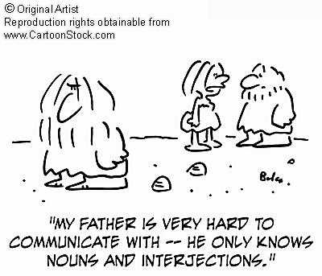
Grammer review
What is a noun?

Slide 5
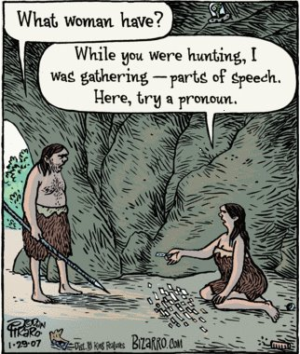
Grammer review
What is a pronoun?

Slide 6

Grammer review
What is a verb?

Slide 7
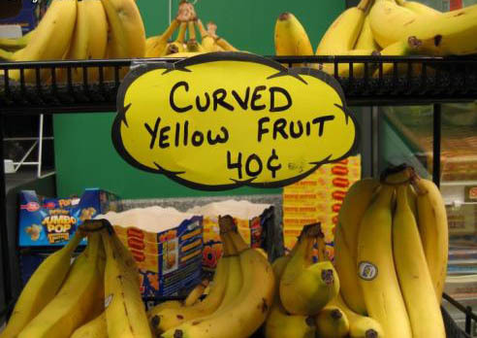
Grammer review
What is an adjective?

Slide 8
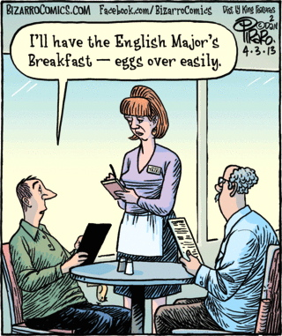
Grammer review
What is an adverb?

Slide 9
Adjectives
What do Hebrew Adjectives look like?
NOUNS | Singular | Plural
Masc | סוּס | סוּסִים
Fem | סוּסָה קֹטֶ֫לֶת | סוּסוֹת
See AnimatedHebrew lecture 7
ADJECTIVES | Singular | Plural
Masc | טוֹב | טוֹבִים
Fem | טוֹבָה | טוֹבוֹת
See AnimatedHebrew lecture 9

Slide 10
Adjectives
Now we’re going to look more closely at how Hebrew Adjectives function.
What do they do?
How should translate them?

Slide 11
Adjectives
Hebrew Adjectives can function in 3 ways.
Attributive
Predicate
Substantive
“Like an adjective.”
“Like a verb.”
“Like a noun.”

Slide 12
Adjectives
Hebrew Adjectives can function in 3 ways.
Attributive
Predicate
Substantive
“Like an adjective.”
What we normally think of as an adjective, i.e. a word that describes a noun.
The red football jersey.
“Like a verb.”
“Like a noun.”

Slide 13
Adjectives
Hebrew Adjectives can function in 3 ways.
Attributive
Predicate
Substantive
“Like an adjective.”
What we normally think of as an adjective, i.e. a word that describes a noun.
The red football jersey.
“Like a verb.”
Occurs in a verbless clause. The adjective describes the subject of the sentence with the verb “to be.”
Red is the football jersey.
“Like a noun.”

Slide 14
Adjectives
Hebrew Adjectives can function in 3 ways.
Attributive
Predicate
Substantive
“Like an adjective.”
What we normally think of as an adjective, i.e. a word that describes a noun.
The red football jersey.
“Like a verb.”
Occurs in a verbless clause. The adjective describes the subject of the sentence with the verb “to be.”
Red is the football jersey.
“Like a noun.”
The adjective takes the place of a noun.
The Reds are winning!
Go Reds!!!

Slide 15
Suggestions for learning Adjectives
View Animated Hebrew lecture 9
  Syntax of the Adjective – Attributive (12:18)
  Syntax of the Adjective – Predicate (11:05)
  Syntax of the Adjective – Substantive (4:48)
Write down the rules for determining each type.
Look at Rocine’s examples (Rocine 18.2a)
      Note that Rocine talks about 2 types of adjectives: predicate and attributive. He includes the substantive as a subset of the attributive (bottom of page 100), which is fine, but his example is actually wrong. It’s an example of the attributive use not substantive.

Slide 16
Independent subject pronouns
 | Singular |  | Plural
3ms | הוּא | 3cp | הֵם
3fs | הִיא |  | הֵן
2ms | אַתָּה | 2mp | אַתֶּם
2fs | אַתְּ | 2fp | אַתֶּן
1cs | אֲנִי אָנֹכִי | 1cp | אֲנַ֫חְנוּ
See AnimatedHebrew lecture 11

Slide 17
Independent subject pronouns
 | Singular |  | Plural
3ms | הוּא | 3cp | הֵם
3fs | הִיא |  | הֵן
2ms | אַתָּה | 2mp | אַתֶּם
2fs | אַתְּ | 2fp | אַתֶּן
1cs | אֲנִי אָנֹכִי | 1cp | אֲנַ֫חְנוּ
See AnimatedHebrew lecture 11

Slide 18
Independent subject pronouns
 | Singular |  | Plural
3ms | הוּא | 3cp | הֵם
3fs | הִיא |  | הֵן
2ms | אַתָּה | 2mp | אַתֶּם
2fs | אַתְּ | 2fp | אַתֶּן
1cs | אֲנִי אָנֹכִי | 1cp | אֲנַ֫חְנוּ
3rd Person all start with ה
2nd and 1st Person all start with א
See AnimatedHebrew lecture 11

Slide 19
Independent subject pronouns
 | Singular |  | Plural
3ms | הוּא | 3cp | הֵם
3fs | הִיא |  | הֵן
2ms | אַתָּה | 2mp | אַתֶּם
2fs | אַתְּ | 2fp | אַתֶּן
1cs | אֲנִי אָנֹכִי | 1cp | אֲנַ֫חְנוּ
3rd Person all start with ה
2nd and 1st Person all start with א
See AnimatedHebrew lecture 11

Slide 20
Independent subject pronouns
 | Singular |  | Plural
3ms | הוּא | 3cp | הֵם
3fs | הִיא |  | הֵן
2ms | אַתָּה | 2mp | אַתֶּם
2fs | אַתְּ | 2fp | אַתֶּן
1cs | אֲנִי אָנֹכִי | 1cp | אֲנַ֫חְנוּ
3rd Person all start with ה
2rd Person
all have ת
2nd and 1st Person all start with א
See AnimatedHebrew lecture 11

Slide 21
Independent subject pronouns
 | Singular |  | Plural
3ms | הוּא | 3cp | הֵם
3fs | הִיא |  | הֵן
2ms | אַתָּה | 2mp | אַתֶּם
2fs | אַתְּ | 2fp | אַתֶּן
1cs | אֲנִי אָנֹכִי | 1cp | אֲנַ֫חְנוּ
3rd Person all start with ה
2rd Person
all have ת
2nd and 1st Person all start with א
See AnimatedHebrew lecture 11

Slide 22
Independent subject pronouns
 | Singular |  | Plural
3ms | הוּא | 3cp | הֵם
3fs | הִיא |  | הֵן
2ms | אַתָּה | 2mp | אַתֶּם
2fs | אַתְּ | 2fp | אַתֶּן
1cs | אֲנִי אָנֹכִי | 1cp | אֲנַ֫חְנוּ
3rd Person all start with ה
2rd Person
all have ת
1st Person
all have נ
2nd and 1st Person all start with א
See AnimatedHebrew lecture 11

Slide 23
Independent subject pronouns
 | Singular |  | Plural
3ms | הוּא | 3cp | הֵם
3fs | הִיא |  | הֵן
2ms | אַתָּה | 2mp | אַתֶּם
2fs | אַתְּ | 2fp | אַתֶּן
1cs | אֲנִי אָנֹכִי | 1cp | אֲנַ֫חְנוּ
3rd Person all start with ה
What does עַתָּה mean?
2rd Person
all have ת
1st Person
all have נ
2nd and 1st Person all start with א
See AnimatedHebrew lecture 11

Slide 24
Irregular nouns
Rocine gives a table of irregular noun forms on page 102 that he says to memorize. haha These are extremely common nouns but I wouldn’t memorize them. Instead
Have a look at the table,
note it’s location in the book so you can find it again
and then come back to it when you encounter these forms in your reading.

Slide 25
Irregular nouns
Table from Rocine 18, p. 102.
 | Father | Brother | Sister | Man | Woman | House | Son | Daughter | Day | City | Name
Singular Absolute | אָב | אָח | אָחוֹת | אִישׁ | אִשָׁה | בַּיִת | בֵּן | בַּת | יוֹם | עִיר | שֵׁם
Singular Construct | אֲבִי | אֲחִי | אֲחוֹת | אִישׁ | אֵ֫שֶׁת | בֵּית | בֶּן | בַּת | יוֹם | עִיר | שֶׁם שֵׁם
Sing. + 2ms sfx | אָבִיךָ | אָחִיךָ | אֲחוֹתְךָ | אִישְׁךָ | אִשְׁתְּךָ | בֵּיתְךָ | בִּנְךָ | בִּתְּךָ | יוֹמְךָ | עִירְךָ | שְׁמֶךָ
Plural Absolute | אָבוֹת | אַחִים | ---- | אֲנָשִׁים | נָשִׁים | בָּתִּים | בָּנִים | בָּנוֹת | יָמִים | עָרִים | שֵׁמוֹת
Plural Construct | אֲבוֹת | אֲחֵי | ---- | אַנְשֵׁי | נְשֵׁי | בָּתֵּי | בְּנֵי | בְּנוֹת | יְמֵי | עָרֵי | שְׁמוֹת
Plural + 2ms sfx | אֲבֹתֶ֫יךָ | אַחֶ֫יךָ | אַחֹתֶ֫יךָ | אֲנָשֶׁ֫יךָ | נָשֶׁ֫יךָ | בָּתֶּ֫יךָ | בָּנֶ֫יךָ | בְּנֹתֶ֫יךָ | יָמֶ֫יךָ | עָרֶ֫יךָ | ----
אָבִי = my father
אָחִי = my brother
בֵּיתִי = my house
אָבֹתַי = my fathers
אַחַי = my brothers

Slide 26
Irregular nouns
Table from Rocine 18, p. 102.
 | Father | Brother | Sister | Man | Woman | House | Son | Daughter | Day | City | Name
Singular Absolute | אָב | אָח | אָחוֹת | אִישׁ | אִשָׁה | בַּיִת | בֵּן | בַּת | יוֹם | עִיר | שֵׁם
Singular Construct | אֲבִי | אֲחִי | אֲחוֹת | אִישׁ | אֵ֫שֶׁת | בֵּית | בֶּן | בַּת | יוֹם | עִיר | שֶׁם שֵׁם
Sing. + 2ms sfx | אָבִיךָ | אָחִיךָ | אֲחוֹתְךָ | אִישְׁךָ | אִשְׁתְּךָ | בֵּיתְךָ | בִּנְךָ | בִּתְּךָ | יוֹמְךָ | עִירְךָ | שְׁמֶךָ
Plural Absolute | אָבוֹת | אַחִים | ---- | אֲנָשִׁים | נָשִׁים | בָּתִּים | בָּנִים | בָּנוֹת | יָמִים | עָרִים | שֵׁמוֹת
Plural Construct | אֲבוֹת | אֲחֵי | ---- | אַנְשֵׁי | נְשֵׁי | בָּתֵּי | בְּנֵי | בְּנוֹת | יְמֵי | עָרֵי | שְׁמוֹת
Plural + 2ms sfx | אֲבֹתֶ֫יךָ | אַחֶ֫יךָ | אַחֹתֶ֫יךָ | אֲנָשֶׁ֫יךָ | נָשֶׁ֫יךָ | בָּתֶּ֫יךָ | בָּנֶ֫יךָ | בְּנֹתֶ֫יךָ | יָמֶ֫יךָ | עָרֶ֫יךָ | ----
אָבִי = my father
אָחִי = my brother
בֵּיתִי = my house
Note typos in Rocine.
There are no dageshim
in these letters.
אָבֹתַי = my fathers
אַחַי = my brothers

Slide 27
Review - Discourse profile of Historical Narrative
Mainline: Wayyiqtol
Off-the-line:
Topicalization: X-qatal
Relative past background: אֲשֶׁר qatal
Transition marker: Wayyiqtol of היה
Scene setting: Verbless Clause
Irrealis scene setting: Negation of any verb by לֹא

Slide 28
Review - Discourse profile of Historical Narrative
Mainline: Wayyiqtol
Off-the-line:
Topicalization: X-qatal
Relative past background: אֲשֶׁר qatal
Transition marker: Wayyiqtol of היה
Scene setting: Verbless Clause
Irrealis scene setting: Negation of any verb by לֹא
Skeleton or Framework
Details: setting, summary, elaboration, etc.

Slide 29
Review - Discourse profile of Historical Narrative
Advances the narrative
Mainline: Wayyiqtol
Off-the-line:
Topicalization: X-qatal
Relative past background: אֲשֶׁר qatal
Transition marker: Wayyiqtol of היה
Scene setting: Verbless Clause
Irrealis scene setting: Negation of any verb by לֹא
Skeleton or Framework
Details: setting, summary, elaboration, etc.
Retards the narrative

Slide 30
Review - Discourse profile of Historical Narrative
Dynamic action
Advances the narrative
Mainline: Wayyiqtol
Off-the-line:
Topicalization: X-qatal
Relative past background: אֲשֶׁר qatal
Transition marker: Wayyiqtol of היה
Scene setting: Verbless Clause
Irrealis scene setting: Negation of any verb by לֹא
Skeleton or Framework
Details: setting, summary, elaboration, etc.
Increasingly static
Retards the narrative

Slide 31
Additions to the Discourse Profile
Mainline: Wayyiqtol
Off-the-line:
Topicalization: X-qatal
Embedded Direct Speech
Relative past background: Qatal in dependent clause
Non-past background: Yiqtol in dependent clause
Backgrounded activities: Participle
Transition marker: Mainline form of היה
Scene setting: Verbless Clause
Irrealis scene setting: Negation of any verb
Rocine 16 Genesis 22 reading
Rocine 13.3
Rocine 12.2

Slide 32
Additions to the Discourse Profile
Historical Narrative
Predictive Narrative
Instructional Discourse
Mainline: Wayyiqtol Weqatal Weqatal
Off-the-line:
Topicalization: X-qatal X-yiqtol X-yiqtol
Embedded Direct Speech
Relative past background: Qatal in dependent clause
Non-past background: Yiqtol in dependent clause
Backgrounded activities: Participle
Transition marker: Mainline form of היה
Scene setting: Verbless Clause
Irrealis scene setting: Negation of any verb

Slide 33
Additions to the Discourse Profile
Historical Narrative
Predictive Narrative
Instructional Discourse
Mainline: Wayyiqtol Weqatal Weqatal
Off-the-line:
Topicalization: X-qatal X-yiqtol X-yiqtol
Embedded Direct Speech
Relative past background: Qatal in dependent clause
Non-past background: Yiqtol in dependent clause
Backgrounded activities: Participle
Transition marker: Mainline form of היה
Scene setting: Verbless Clause
Irrealis scene setting: Negation of any verb
“Fortunately for the student of Biblical Hebrew the discourse profile schemes for the different genres are different only at and near the mainline. The lower ranked constructions like dependent clauses, verbless clause, the participle, theהיה forms, and irrealis have the same functions in almost all genres.” (Rocine p. 103)

