Slide 1

Rocine Lesson 10
וַיָּבֹא עַד־הַיַּרְדֵּן וִיהוּדָה בָּא
2 Samuel 19:16

Slide 2
Goals
Identify and read Qal wayyiqtol and qatal forms derived from hollow roots.

Slide 3
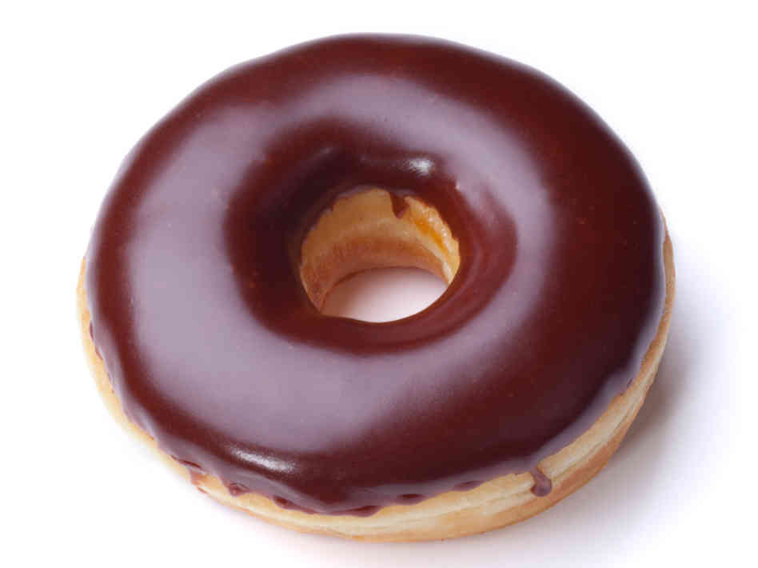
Goals
Identify and read Qal wayyiqtol and qatal forms derived from hollow roots.

Slide 4
What we already know
וַיָּבֹא עַד־הַיַּרְדֵּן וִיהוּדָה בָּא
What do you recognize in the first word of our lesson sentence?
Form:
Function:
Subject pronoun:

Slide 5
What we already know
וַיָּבֹא עַד־הַיַּרְדֵּן וִיהוּדָה בָּא
What do you recognize in the first word of our lesson sentence?
Form: | Wayyiqtol
Function: | Historical narrative; mainline
Subject pronoun: | Yod (3 m) No וּ affix complement, therefore not plural

Slide 6
Wayyiqtol of hollow or secondוֹ וּ י verbs
וַיָּבֹא עַד־הַיַּרְדֵּן וִיהוּדָה בָּא
We see only 2 root letters, so where do we look?

Slide 7
Wayyiqtol of hollow or secondוֹ וּ י verbs
וַיָּבֹא עַד־הַיַּרְדֵּן וִיהוּדָה בָּא
We see only 2 root letters, so where do we look?
Under the prefix consonant

Slide 8
Wayyiqtol of hollow or secondוֹ וּ י verbs
וַיָּבֹא עַד־הַיַּרְדֵּן וִיהוּדָה בָּא
Our 4th Missing Letter Rule
When we see a qamets ָ under the prefix pronoun
  the missing letter is the second or middle letter
  and will be a וּ or וֹ or י.
Any root with one of these letters as its middle letter has the nickname hollow root.

Slide 9
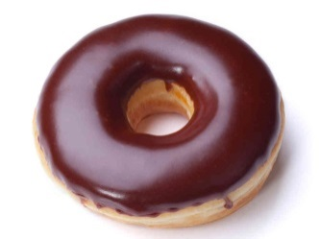
Wayyiqtol of hollow or secondוֹ וּ י verbs
וַיָּבֹא עַד־הַיַּרְדֵּן וִיהוּדָה בָּא
Our 4th Missing Letter Rule
When we see a qamets ָ under the prefix pronoun
  the missing letter is the second or middle letter
  and will be a וּ or וֹ or י.
Any root with one of these letters as its middle letter has the nickname hollow root.

Slide 10
Wayyiqtol of hollow or secondוֹ וּ י verbs
וַיָּבֹא עַד־הַיַּרְדֵּן וִיהוּדָה בָּא
Our 4th Missing Letter Rule
When we see a qamets ָ under the prefix pronoun
  the missing letter is the second or middle letter
  and will be a וּ or וֹ or י.
Any root with one of these letters as its middle letter has the nickname hollow root.
II-ו
II-י

Slide 11
4 types of missing letter verbs
I-י
י
III-ה
ה
I-נ
נ
ו
II-ו
II-י
י

Slide 12
4 types of missing letter verbs
I-י
י
וַ ֵ
III-ה
ה
I-נ
נ
ו
II-ו
II-י
י

Slide 13
4 types of missing letter verbs
I-י
י
וַ ֵ
וַ ַ
III-ה
ה
וַ ִ
I-נ
נ
ו
II-ו
II-י
י

Slide 14
4 types of missing letter verbs
I-י
י
וַ ֵ
וַ ַ
III-ה
ה
וַ ִ
I-נ
נ
וַ ִ
ו
II-ו
II-י
י

Slide 15
4 types of missing letter verbs
I-י
י
וַ ֵ
וַ ַ
III-ה
ה
וַ ִ
I-נ
נ
וַ ִ
ו
II-ו
II-י
וַ ָ
י

Slide 16

4 types of missing letter verbs
I-י
י
וַ ֵ
וַ ַ
III-ה
ה
וַ ִ
I-נ
נ
וַ ִ
ו
II-ו
II-י
וַ ָ
י

Slide 17
Qatal of hollow roots
II-ו
II-י
וַיָּבֹא עַד־הַיַּרְדֵּן וִיהוּדָה בָּא
Waw missing in wayyiqtol and qatal

Slide 18
Qatal of hollow roots
II-ו
II-י
וַיָּבֹא עַד־הַיַּרְדֵּן וִיהוּדָה בָּא
Waw missing in wayyiqtol and qatal
Missing letter rules are for wayyiqtol (yiqtol) verbs, not qatal. So, what is a sign of the qatal?

Slide 19
Qatal of hollow roots
II-ו
II-י
וַיָּבֹא עַד־הַיַּרְדֵּן וִיהוּדָה בָּא
Waw missing in wayyiqtol and qatal
Missing letter rules are for wayyiqtol (yiqtol) verbs, not qatal. So, what is a sign of the qatal?
We have 2 signs
  Qamets under first root letter = Qal qatal (Rocine 4.3g)
  Hireq under first root letter = Piel qatal (Rocine 6.2b)

Slide 20
Qatal of hollow roots
II-ו
II-י
וַיָּבֹא עַד־הַיַּרְדֵּן וִיהוּדָה בָּא
Qal | Piel
שָׁלַח | שִׁלַּח
נָשָׂא | נִשָּׂא
Compare first root vowels

Slide 21
Qatal of hollow roots
II-ו
II-י
וַיָּבֹא עַד־הַיַּרְדֵּן וִיהוּדָה בָּא
Qal | Piel
שָׁלַח | שִׁלַּח
נָשָׂא | נִשָּׂא
Compare
first root
vowels
Qal | Piel
שָׁב
בָּא
קָם
שָׂם
מֵת

Slide 22
Qatal of hollow roots
II-ו
II-י
וַיָּבֹא עַד־הַיַּרְדֵּן וִיהוּדָה בָּא
Qal | Piel
שָׁלַח | שִׁלַּח
נָשָׂא | נִשָּׂא
Qal | Piel
שָׁב | -
בָּא | -
קָם | קִיַּם only 2x
שָׂם | -
מֵת | -
Hollow verbs
rarely
form Piels.

Slide 23
Qatal of hollow roots
II-ו
II-י
וַיָּבֹא עַד־הַיַּרְדֵּן וִיהוּדָה בָּא
Qal | Piel
שָׁלַח | שִׁלַּח
נָשָׂא | נִשָּׂא
Qal | Piel
שָׁב | -
בָּא | -
קָם | קִיַּם only 2x
שָׂם | -
מֵת | -
Why?
It’s hard to double the “nothing”
in the middle.

Slide 24
Qatal of hollow roots
II-ו
II-י
וַיָּבֹא עַד־הַיַּרְדֵּן וִיהוּדָה בָּא
Qal | Piel
שָׁלַח | שִׁלַּח
נָשָׂא | נִשָּׂא
Qal | (dictionary form) | Piel
שָׁב | שׁוּב | -
בָּא | בּוֹא | -
קָם | קוּם | קִיַּם only 2x
שָׂם | שִׂים | -
מֵת | מוּת | -
The lexical form for verbs
(i.e. the form you look up in a dictionary)
is Qatal 3ms.
However, for Hollow verbs, a different form is used so we can see all three root letters.

