Slide 1

Rocine Lesson 4
וַיִּשְׁמַע יִתְרוֹ אֵת כָּל־אֲשֶׁר עָשָׂה אֱלֹהִים
Exodus 18:1

Slide 2
Goals
Identify
  a dependent clause by a relative pronoun.
Identify and read
  the relative past background
  Qal qatal in a dependent clause.

Slide 3
What we already know
וַיִּשְׁמַע יִתְרוֹ אֵת כָּל־אֲשֶׁר עָשָׂה אֱלֹהִים
What form is the first verb?
What genre does that form indicate?
What is the
  Subject?
  Object?

Slide 4
What we already know
וַיִּשְׁמַע יִתְרוֹ אֵת כָּל־אֲשֶׁר עָשָׂה אֱלֹהִים
What form is the first verb?
What genre does that form indicate?
What is the
  Subject?
  Object?
wayyiqtol
Historical
Narrative

Slide 5
What we already know
וַיִּשְׁמַע יִתְרוֹ אֵת כָּל־אֲשֶׁר עָשָׂה אֱלֹהִים
How is כָּל pronounced?
Meaning of שמע (Vocab # 27, p 412)
Translate what we can.

Slide 6
What we already know
וַיִּשְׁמַע יִתְרוֹ אֵת כָּל־אֲשֶׁר עָשָׂה אֱלֹהִים
‘kol’
short ‘o’ qamets-hatuph, not the long ‘a’ qamets.
Remember ‘closed, unaccented syllable’ means qamets-hatuph.
How is כָּל pronounced?
Meaning of שמע (Vocab # 27, p 412)
Translate what we can.

Slide 7
All-purpose Relative Pronoun
וַיִּשְׁמַע יִתְרוֹ אֵת כָּל־אֲשֶׁר עָשָׂה אֱלֹהִים
אֲשֶׁר (Vocab # 2, p 411)
  The ‘all-purpose’ relative pronoun in BH
  Trans: what, that, who, which, whomever…
  Signals a dependent clause

Slide 8
All-purpose Relative Pronoun
וַיִּשְׁמַע יִתְרוֹ אֵת כָּל־אֲשֶׁר עָשָׂה אֱלֹהִים
אֲשֶׁר (Vocab # 2, p 411)
  The ‘all-purpose’ relative pronoun in BH
  Trans: what, that, who, which, whomever…
  Signals a dependent clause
Two other words that start a dependent clause
  אִם = "if" (Vocab # 39, p 412)
  כִּי = "when, because" (Vocab # 8, p 412)

Slide 9
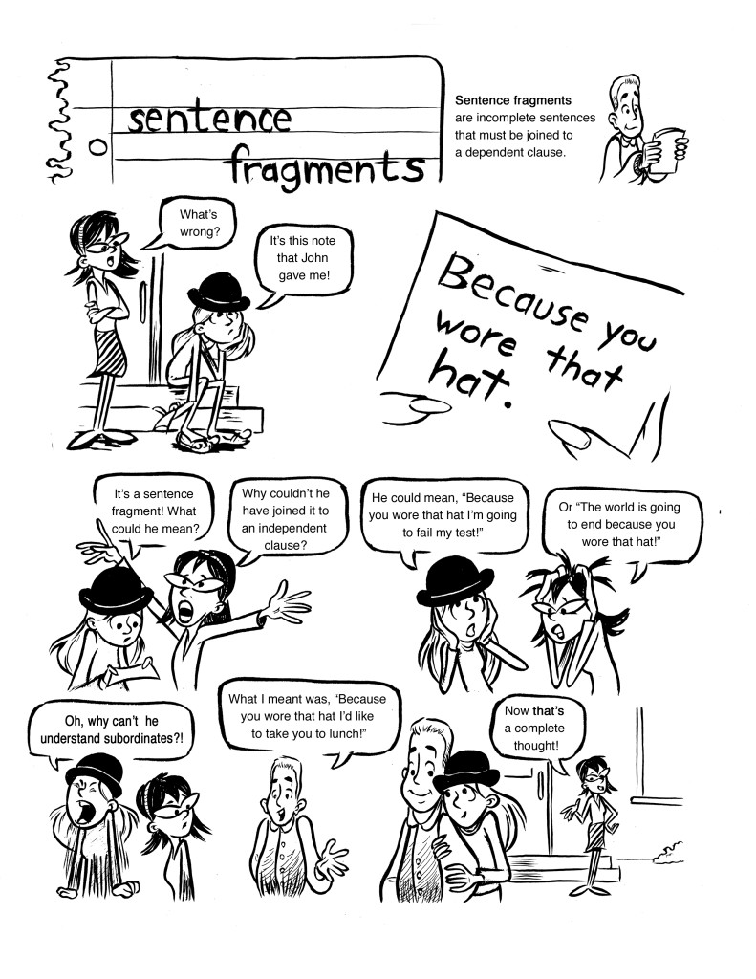
Find the dependent clause.
Why can’t dependent clauses stand alone?

Slide 10
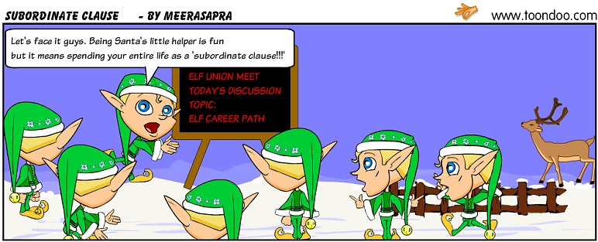
What’s another name for a dependent clause?

Slide 11
Qatal
וַיִּשְׁמַע יִתְרוֹ אֵת כָּל־אֲשֶׁר עָשָׂה אֱלֹהִים
Qatal is a verb form (like wayyiqtol).
Try to identify the qatal and the wayyiqtol.

Slide 12
Qatal
וַיִּשְׁמַע יִתְרוֹ אֵת כָּל־אֲשֶׁר עָשָׂה אֱלֹהִים
qatal
wayyiqtol
List as many similarities/differences as you can.

Slide 13
Qatal
וַיִּשְׁמַע יִתְרוֹ אֵת כָּל־אֲשֶׁר עָשָׂה אֱלֹהִים
qatal
wayyiqtol
List as many similarities/differences as you can.
Differences
prefix vs. no prefix
waw/patach/dagesh forte front end
vowels are different
Similarities
3 root letters
subject follows

Slide 14
Mainline vs. Off-the-line
וַיִּשְׁמַע יִתְרוֹ אֵת כָּל־אֲשֶׁר עָשָׂה אֱלֹהִים
qatal
wayyiqtol
RULE:
Every genre of discourse has a mainline clause type constructed with a particular verb form. All other clause types (constructed with other verb forms) within that genre are off-the-line.
Off-the-line clauses are subordinate to, or serve the mainline.
Each off-the-line verb form has functions that are particular to it.

Slide 15
Mainline vs. Off-the-line
וַיִּשְׁמַע יִתְרוֹ אֵת כָּל־אֲשֶׁר עָשָׂה אֱלֹהִים
qatal
wayyiqtol
In this verse which verb form is
  Mainline?
  Off-line?

Slide 16
Mainline vs. Off-the-line
וַיִּשְׁמַע יִתְרוֹ אֵת כָּל־אֲשֶׁר עָשָׂה אֱלֹהִים
qatal
wayyiqtol
In the Historical Narrative genre
  Wayyiqtol is mainline
    This is the tense used to move the story forward, to describe each event in sequence.
  Qatal is off-line
    Qatal will do things in the story other than tell us what the next event is.

Slide 17
Qatal
וַיִּשְׁמַע יִתְרוֹ אֵת כָּל־אֲשֶׁר עָשָׂה אֱלֹהִים
qatal
wayyiqtol
Qatal can be used in 2 ways in Historical Narrative
Both are off-line
  In a dependent clause (this lesson)
  In an independent clause (next lesson)

Slide 18
Qatal in dependent clause
וַיִּשְׁמַע יִתְרוֹ אֵת כָּל־אֲשֶׁר עָשָׂה אֱלֹהִים
qatal
wayyiqtol
In a dependent clause, Qatal gives “relative past background” information
  This is information set in the past, relative to the time frame of the story

Slide 19
Qatal in dependent clause
וַיִּשְׁמַע יִתְרוֹ אֵת כָּל־אֲשֶׁר עָשָׂה אֱלֹהִים
qatal
wayyiqtol
In a dependent clause, Qatal gives “relative past background” information
  This is information set in the past, relative to the time frame of the story
The Qatal is in a dependent clause when it follows אֲשֶׁר or אִם orכִּי

Slide 20
Qatal in dependent clause
וַיִּשְׁמַע יִתְרוֹ אֵת כָּל־אֲשֶׁר עָשָׂה אֱלֹהִים
qatal
wayyiqtol
past
present
future

Slide 21
Qatal in dependent clause
וַיִּשְׁמַע יִתְרוֹ אֵת כָּל־אֲשֶׁר עָשָׂה אֱלֹהִים
qatal
wayyiqtol
What God did
Jethro
heard
past
אֲשֶׁר
present
future
qatal
wayyiqtol

Slide 22
Qatal in dependent clause
וַיִּנָּחֶם יְהוָה כִּי־עָשָׂה אֶת־הָאָדָם בָּאָרֶץ
past
present
future

Slide 23
Qatal in dependent clause
וַיִּנָּחֶם יְהוָה כִּי־עָשָׂה אֶת־הָאָדָם בָּאָרֶץ
qatal
wayyiqtol
past
present
future

Slide 24
Qatal in dependent clause
וַיִּנָּחֶם יְהוָה כִּי־עָשָׂה אֶת־הָאָדָם בָּאָרֶץ
qatal
wayyiqtol
past
present
future

Slide 25
Qatal in dependent clause
וַיִּנָּחֶם יְהוָה כִּי־עָשָׂה אֶת־הָאָדָם בָּאָרֶץ
qatal
wayyiqtol
YHWH
made man
YHWH
regretted
past
כִּי
present
future
qatal
wayyiqtol

Slide 26
Qatal in dependent clause
וַיִּשְׁמַע יִתְרוֹ אֵת כָּל־אֲשֶׁר עָשָׂה אֱלֹהִים
qatal
wayyiqtol
וַיִּנָּחֶם יְהוָה כִּי־עָשָׂה אֶת־הָאָדָם בָּאָרֶץ
qatal
wayyiqtol
past
אֲשֶׁר
present
future
qatal
wayyiqtol
כִּי

Slide 27
Qatal in dependent clause
וַיִּשְׁמַע יִתְרוֹ אֵת כָּל־אֲשֶׁר עָשָׂה אֱלֹהִים
qatal
wayyiqtol
וַיִּנָּחֶם יְהוָה כִּי־עָשָׂה אֶת־הָאָדָם בָּאָרֶץ
qatal
wayyiqtol
Past relative to
past
past
אֲשֶׁר
present
future
qatal
wayyiqtol
כִּי

Slide 28
Qatal in dependent clause
וַיִּשְׁמַע יִתְרוֹ אֵת כָּל־אֲשֶׁר עָשָׂה אֱלֹהִים
qatal
wayyiqtol
RULE:
A qatal form, when in a dependent clause, functions in Biblical Hebrew by giving background in the relative past.
  Relative past means past as compared to the main clause of the sentence.
In Historical Narrative the main clause will most often be the wayyiqtol clause.

Slide 29
Qatal – What does it look like?
וַיִּשְׁמַע יִתְרוֹ אֵת כָּל־אֲשֶׁר עָשָׂה אֱלֹהִים
qatal
wayyiqtol
Wayyiqtol has prefixes.
  (stuff that comes before the root)
Qatal has affixes.
  (stuff that comes after the root)
  Note that in this particular qatal, the affix is “Null”, in other words there isn’t one. This is the base form. It’s the form used for ‘he’, 3rd masculine, singular.

Slide 30
Qatal – What does it look like?
וַיִּשְׁמַע יִתְרוֹ אֵת כָּל־אֲשֶׁר עָשָׂה אֱלֹהִים
qatal
wayyiqtol
Here are a couple more qatals just to see some of the variety. This is not a full list.
שָׁמַע, עָשָׂה | שָׁמַ֫עְתָּ
[∅] affix meaning “he” | [תָּ] affix meaning “you”

Slide 31
Qatal – What does it look like?
וַיִּשְׁמַע יִתְרוֹ אֵת כָּל־אֲשֶׁר עָשָׂה אֱלֹהִים
Let’s try parsing these verbs.
Root | Stem | Form | Person, Gender, Number | Function | Root meaning
שׁמע
עשׂה
Note 1: A Qatal form in the Qal stem will have qamets under the first root letter.
Note 2: The word order with the Qatal here is the same as usual: V-S (verb then subject).

Slide 32
Qatal – What does it look like?
וַיִּשְׁמַע יִתְרוֹ אֵת כָּל־אֲשֶׁר עָשָׂה אֱלֹהִים
Let’s try parsing these verbs.
Root | Stem | Form | Person, Gender, Number | Function | Root meaning
שׁמע | Qal | Wayyiqtol | 3ms | Historical Narrative Mainline | To hear
עשׂה
Note 1: A Qatal form in the Qal stem will have qamets under the first root letter.
Note 2: The word order with the Qatal here is the same as usual: V-S (verb then subject).

Slide 33
Qatal – What does it look like?
וַיִּשְׁמַע יִתְרוֹ אֵת כָּל־אֲשֶׁר עָשָׂה אֱלֹהִים
Let’s try parsing these verbs.
Root | Stem | Form | Person, Gender, Number | Function | Root meaning
שׁמע | Qal | Wayyiqtol | 3ms | Historical Narrative Mainline | To hear
עשׂה | Qal | Qatal | 3ms | Qatal in dep. clause = Rel. past background | To do
Note 1: A Qatal form in the Qal stem will have qamets under the first root letter.
Note 2: The word order with the Qatal here is the same as usual: V-S (verb then subject).

