Slide 1
Key Slides from Rocine
Charles Grebe www.animatedhebrew.com
*
Textbook available from
http://www.helwys.com/sh-books/learning-biblical-hebrew/
* Note that not all these slides are from Rocine. Some are supplemental material related to particular chapters in Rocine.

Slide 2
Summary of Qatal and Wayyiqtol
 | QATAL IN DEPENDENT CLAUSES (Lesson 4) | QATAL IN INDEPENDENT CLAUSES (Lesson 5) | WAYYIQTOL (Lessons 1, 2, 3)
Preceded by | a relative, e.g. כִּי אִם אֲשֶׁר | any other word or phrase, i.e. an “X” | nothing
Translate | has, had, have | (And) it was “X” who(that) ____ | Usually as an English past tense
“Function” | Qatal in dep. clause = relative past background | X-qatal = topicalization | Historical narrative Mainline
Example | וַיִּשְׁמַע יִתְרוֹ אֵת כָּל־אֲשֶׁר עָשָׂה אֱלֹהִים Jethro heard all which God had done. | וּלְאָדָם אָמַר And it was to Adam that he was a sayer. | וַיֹּ֫אמֶר יהוה YHWH said וַיְּדַבֵּר אֱלֹהִים אֶל־מֹשֶׁה וַיֹּ֫אמֶר אֵלָיו אֲנִי יהוה God spoke to Moses and said to him, “I am YHWH” וַיֵּ֫לֶךְ מֹשֶׁה וַיְדַבֵּר אֶת־הַדְּבָרִים אֶל־כָּל־יִשְׂרָאֵל Moses went and spoke the words to all Israel
Rocine 5 Summary Qatal Wayyiqtol
Notes:
Rocine 5

Slide 3
4 types of missing letter verbs
I-י
י
וַ ֵ
וַ ַ
III-ה
ה
וַ ִ
I-נ
נ
וַ ִ
ו
II-ו
II-י
וַ ָ
י
Rocine 10 Missing Letter Rules
Notes:
Rocine 10

Slide 4
Genres
MODULE ONE: outside the “quotation marks” | MODULE TWO: inside the “quotation marks” or Direct Speech
Historical Narrative | Predictive Narrative Instructional Discourse Hortatory Discourse Historical Narrative
+projection or
forward-looking genres
Genre | Task
Historical Narrative | Tell a story about the past.
Predictive Narrative | Tell a story set in the future.
Instructional Discourse | Tell how to do something.
Hortatory Discourse | Influence the behavior of someone.
Module 1 and 2 Genres

Slide 5
Discourse profile
Dynamic
action
Advances the narrative
Mainline: Wayyiqtol
Off-the-line:
Topicalization: X-qatal
Relative past background: אֲשֶׁר qatal
Transition marker: Wayyiqtol of היה
Scene setting: Verbless Clause
Irrealis scene setting: Negation of any verb by לֹא
Skeleton or Framework
Details: setting, summary, elaboration, etc.
Increasingly static
Retards the narrative
Note: This is not a ranking of importance.
It is a ranking of movement in the narrative – the lower the rank the more that construction slows the forward progress of the discourse.
Sometimes off-line constructions contain the most important material: like a “slow-mo” section of a video or even a “freeze frame”.
Rocine 11 Discourse Profile
Notes:
Rocine 11

Slide 6
Discourse Profile – Other Genres
Historical Narrative
Predictive Narrative
Instructional Discourse
Mainline: Wayyiqtol Weqatal Weqatal
Off-the-line:
Topicalization: X-qatal X-yiqtol X-yiqtol
Relative past background: Qatal in dependent clause
Non-past background: Yiqtol in dependent clause
Backgrounded activities: Participle
Transition marker: Mainline form of היה
Scene setting: Verbless Clause
Irrealis scene setting: Negation of any verb
“Fortunately for the student of Biblical Hebrew the discourse profile schemes for the different genres are different only at and near the mainline. The lower ranked constructions like dependent clauses, verbless clause, the participle, theהיה forms, and irrealis have the same functions in almost all genres.” (Rocine p. 103)
Rocine 18 Discourse Profile

Slide 7
Summary of Verbs (with X-yiqtol)
קָטַל
וְקָטַל
וְ x קָטַל
וַיִּקְטֹל
יִקְטֹל
וְ x יִקְטֹל
Genre: Historical Narrative
Funct: In dep. Clause =
Rel past background
Trans: past, pluperfect
Genre: Historical Narrative
Funct: Mainline
Trans: past (usually)
Genre: Forward-looking
Funct: Mainline
Trans: future or volitive
will be/wants them to be
Genre: Any
Funct: In dep. Clause =
Rel non-past background
Trans: present or future
Genre: Historical Narrative
Funct: Topicalization
Trans: (And) it was X that was a ______ (of)
(i.e. the “X” is in focus, it is the “topic”)
Genre: forward-looking
Funct: Topicalization
Trans: (And) it will be X who(that) will ____
(And) it is X who(that) _______
Rocine 14 Summary of Verbs

Slide 8
The Four Component Hebrew Verb System
The wayyiqtol, yiqtol, weqatal, and qatal verb forms can be paired in 3 different ways to create a simple overview of the Hebrew Verbal system as we have learned it so far.
Here are the 4 forms. (Note that the X-forms are combined with the non-X forms.)
Let us look at each of the 3 pairings in turn.
(x) קָטַל
וַיִּקְטֹל
Genre: Historical Narrative
Funct: In dep. Clause = Rel past background
X-qatal = Topicalization (past)
Trans: past, pluperfect
Genre: Historical Narrative
Funct: Mainline
Trans: past (usually)
וְקָטַל
(x) יִקְטֹל
Genre: Yiqtol = any; X-yiqtol = forward-looking
Funct: In dep. Clause = Rel non-past background
X-yiqtol = Topicalization (non-past)
Trans: present or future
Genre: Forward-looking
Funct: Mainline
Trans: future or volitive
Rocine 14 Four Component Verb System

Slide 9
The Four Component Hebrew Verb System
Rocine 14
Four Component
Verb System
What do these forms share?
(x) קָטַל
וַיִּקְטֹל
Genre: Historical Narrative
Funct: In dep. Clause = Rel past background
X-qatal = Topicalization (past)
Trans: past, pluperfect
Genre: Historical Narrative
Funct: Mainline
Trans: past (usually)
וְקָטַל
(x) יִקְטֹל
Genre: Yiqtol = any; X-yiqtol = forward-looking
Funct: In dep. Clause = Rel non-past background
X-yiqtol = Topicalization (non-past)
Trans: present or future
Genre: Forward-looking
Funct: Mainline
Trans: future or volitive

Slide 10
The Four Component Hebrew Verb System
Rocine 14
Four Component
Verb System
Shared Genres
-Projection: Historical Narrative
(x) קָטַל
וַיִּקְטֹל
Genre: Historical Narrative
Funct: In dep. Clause = Rel past background
X-qatal = Topicalization (past)
Trans: past, pluperfect
Genre: Historical Narrative
Funct: Mainline
Trans: past (usually)
+Projection: Predictive, Instructional, Hortatory
וְקָטַל
(x) יִקְטֹל
Genre: Yiqtol = any; X-yiqtol = forward-looking
Funct: In dep. Clause = Rel non-past background
X-yiqtol = Topicalization (non-past)
Trans: present or future
Genre: Forward-looking
Funct: Mainline
Trans: future or volitive

Slide 11
The Four Component Hebrew Verb System
Rocine 14
Four Component
Verb System
What do these forms share?
(x) קָטַל
וַיִּקְטֹל
Genre: Historical Narrative
Funct: In dep. Clause = Rel past background
X-qatal = Topicalization (past)
Trans: past, pluperfect
Genre: Historical Narrative
Funct: Mainline
Trans: past (usually)
וְקָטַל
(x) יִקְטֹל
Genre: Yiqtol = any; X-yiqtol = forward-looking
Funct: In dep. Clause = Rel non-past background
X-yiqtol = Topicalization (non-past)
Trans: present or future
Genre: Forward-looking
Funct: Mainline
Trans: future or volitive

Slide 12
The Four Component Hebrew Verb System
Rocine 14
Four Component
Verb System
Shared Discourse Functions
Off-the-line
No waw
Usu. not clause-initial
Mainline
Have waw
Clause-initial
(x) קָטַל
וַיִּקְטֹל
Genre: Historical Narrative
Funct: In dep. Clause = Rel past background
X-qatal = Topicalization (past)
Trans: past, pluperfect
Genre: Historical Narrative
Funct: Mainline
Trans: past (usually)
Mainline
Have waw
Clause-initial
Off-the-line
No waw
Usu. not clause-initial
וְקָטַל
(x) יִקְטֹל
Genre: Yiqtol = any; X-yiqtol = forward-looking
Funct: In dep. Clause = Rel non-past background
X-yiqtol = Topicalization (non-past)
Trans: present or future
Genre: Forward-looking
Funct: Mainline
Trans: future or volitive

Slide 13
The Four Component Hebrew Verb System
Rocine 14
Four Component
Verb System
What do these forms share?
(x) קָטַל
וַיִּקְטֹל
Genre: Historical Narrative
Funct: In dep. Clause = Rel past background
X-qatal = Topicalization (past)
Trans: past, pluperfect
Genre: Historical Narrative
Funct: Mainline
Trans: past (usually)
וְקָטַל
(x) יִקְטֹל
Genre: Yiqtol = any; X-yiqtol = forward-looking
Funct: In dep. Clause = Rel non-past background
X-yiqtol = Topicalization (non-past)
Trans: present or future
Genre: Forward-looking
Funct: Mainline
Trans: future or volitive

Slide 14
The Four Component Hebrew Verb System
Rocine 14
Four Component
Verb System
Shared Meanings
Pins attribute on subject.
Focus on the whole adjectively or statively.
Describes emerging action.
Focus on the process.
(x) קָטַל
וַיִּקְטֹל
Genre: Historical Narrative
Funct: In dep. Clause = Rel past background
X-qatal = Topicalization (past)
Trans: past, pluperfect
Genre: Historical Narrative
Funct: Mainline
Trans: past (usually)
וְקָטַל
(x) יִקְטֹל
Genre: Yiqtol = any; X-yiqtol = forward-looking
Funct: In dep. Clause = Rel non-past background
X-yiqtol = Topicalization (non-past)
Trans: present or future
Genre: Forward-looking
Funct: Mainline
Trans: future or volitive

Slide 15
The Four Component Hebrew Verb System
Rocine 14
Four Component
Verb System
Shared Meanings
Pins attribute on subject.
Focus on the whole adjectively or statively.
Describes emerging action.
Focus on the process.
(x) קָטַל
וַיִּקְטֹל
Genre: Historical Narrative
Funct: In dep. Clause = Rel past background
X-qatal = Topicalization (past)
Trans: past, pluperfect
Genre: Historical Narrative
Funct: Mainline
Trans: past (usually)
Expresses facts like snap shots on which appear the qatal or weqatal “mini-sentences” as captions.
Describe action as it emerges like a video with sound.
וְקָטַל
(x) יִקְטֹל
Genre: Yiqtol = any; X-yiqtol = forward-looking
Funct: In dep. Clause = Rel non-past background
X-yiqtol = Topicalization (non-past)
Trans: present or future
Genre: Forward-looking
Funct: Mainline
Trans: future or volitive

Slide 16
The Four Component Hebrew Verb System
Rocine 14
Four Component
Verb System
Shared Meanings
Pins attribute on subject.
Focus on the whole adjectively or statively.
Describes emerging action.
Focus on the process.
(x) קָטַל
וַיִּקְטֹל
Perfective
Imperfective (?)
Genre: Historical Narrative
Funct: In dep. Clause = Rel past background
X-qatal = Topicalization (past)
Trans: past, pluperfect
Genre: Historical Narrative
Funct: Mainline
Trans: past (usually)
Expresses facts like snap shots on which appear the qatal or weqatal “mini-sentences” as captions.
Describe action as it emerges like a video with sound.
וְקָטַל
Imperfective
(x) יִקְטֹל
Perfective
Genre: Yiqtol = any; X-yiqtol = forward-looking
Funct: In dep. Clause = Rel non-past background
X-yiqtol = Topicalization (non-past)
Trans: present or future
Genre: Forward-looking
Funct: Mainline
Trans: future or volitive

Slide 17
Summary of Volitional Forms
 | Cohortative | Imperative | Jussive
Person | 1st | 2nd | 3rd
Yiqtol change | Usually adds ה | Loses prefix pronoun May add ה (Rocine 22.2) | May shorten
Translation | Let me/us… May I/we… | Do! | Let him/her/them… May he/she/they…
Rocine 24 Volitional Forms Summary

Slide 18
הִנֵּה and הֵן
Very frequent in Hebrew Bible
הִנֵּה / הֵן = 1059x
הִנֵּה / הֵן + sfx = 248x
וַתֹּ֫אמֶר לִנְעָרֶ֫יהָ עִבְרוּ לְפָנַי הִנְנִי אַחֲרֵ֫יכֶם בָּאָה
הִנֵּ֙ה אֲנִ֜י (2 Kings 10:9) It was I …
וְהִנְנִ֥י (Gen 6:13) Behold, I…
הִנֶּ֣נִּֽי (Gen 22:7) Here I am.
הִנֵּֽנִי׃ (Gen 22:1) Here I am.
וַאֲנִ֗י הִנְנִי֩ (Gen 6:17; 9:9) For behold, I …
הִנָּ֥ךְ (Gen 16:11) Behold, you (fs)…
הִנְּךָ֥ (Gen 20:3) Behold, you (ms)…
וְהִנָּ֖ם (Gen 40:6) Behold, they…
Forms separated
Same as lesson verse
More common
Pausal
Lots of emphasis
Second
person
3mp
Rocine 25 Hinne

Slide 19
Discourse Profile for Hortatory Discourse
Mainline: a. Imperative
b. Weqatal (for Mitigated Hortatory Discourse)
c. Jussive
d. Cohortative
Off-the-line:
Topicalization: X-Imperative / X-Jussive / X-Cohortative
Prohibitive Commands: אַל or לֹא + yiqtol
Consequence, purpose: Weqatal
Backgrounded activities: Participle
Scene setting: Verbless Clause
Lesson 19
Lesson 23
Lesson 24
Lesson 21.6b.4
Lesson 24.4
Lesson 21
Lesson 22
Rocine 24/26 Hortatory Discourse Profile

Slide 20
Opening oral Historical Narratives with a qatal
וַיֹּאמְרוּ בָּ֫אנוּ אֶל־הָאָ֫רֶץ אֲשֶׁר שְׁלַחְתָּ֫נוּ
There are 2 qatals in our lesson verse
Let’s parse the first one.
Root | Stem | Form | PGN | Function | Root meaning
בּוֹא | Qal | Qatal | 1cp | Open an oral Historical Narrative | To come, go, enter
What is the function?
X-qatal / topicalization ?
Qatal in dep. clause / rel. past background ?
Other
ü
Rocine 26 Open Oral Historical Narrative

Slide 21
Opening oral Historical Narratives with a qatal
וַיֹּאמְרוּ בָּ֫אנוּ אֶל־הָאָ֫רֶץ אֲשֶׁר שְׁלַחְתָּ֫נוּ
RULE:
A clause-initial qatal often opens Historical Narrative that is within direct speech.
A wayyiqtol never does.
After the opening clause of an oral Historical Narrative, it proceeds just like any non-oral Historical Narrative.
An oral H.N. can also begin with
X-qatal
Verbless clause
Clause with a participle
BUT
Not a wayyiqtol
Historical Narrative
Begins with Wayyiqtol
Oral Historical Narrative
Does not
Rocine 26 Open Oral Historical Narrative

Slide 22
Hiphils of motion verbs
There are many verbs of motion with which we are quite familiar that can be translated using brought and a particle of direction. Often the direction is lost in the commonly used English versions, so it is nice to know the Hebrew.
ROOT | QAL MEANING | HIPHIL MEANING
ירד | Descend | Bring down
עלה | Ascend | Bring up
בּוא | Come, enter | Bring in
יצא | Exit, leave | Bring out
שׁוב | Return | Bring back
קרב | Approach | Bring near
הלך | Go, walk | Bring
Rocine 28 Hiphils of Motion
Notes:
Middle root letter missing so I/E vowel now on first root letter
I/E vowel sometimes missing in some forms (typically second and third persons)

Slide 23
Terms
Stative | A stative verb is a verb that expresses a state of affairs or being rather than action. | be, have, know, love, hate, like, doubt, seem, own, understand
Dynamic | A verb that expresses an action. | eat, walk, learn, grow, sleep, talk, write, run, read, become, go
Active | Active voice is a voice that indicates a subject has the semantic function of actor. | Jones built the house.
Passive | Passive voice is a voice that indicates that the subject is the patient or recipient of the action denoted by the verb. | The house was built by Jones.
Transitive | A transitive verb is a verb that takes a direct object. | I drink coffee every day.
Intransitive | Intransitivity is a term that describes a verb or clause that is unable to take a direct object. | I run every day.
http://www-01.sil.org/linguistics/GlossaryOfLinguisticTerms/
http://www.really-learn-english.com/dynamic-verbs-and-stative-verbs.html
http://web2.uvcs.uvic.ca/elc/sample/beginner/gs/gs_09.htm
Rocine 33 Terms

Slide 24
ROOTS that are STATIVE in the QAL
ירא | Be afraid | חזק | Be strong, firm
מלא | Be full | כּלה | Be complete, finished
רוּם | Be high, exalted | יכל | Be able
אבד | Be lost | קדשׁ | Be holy
טמא | Be unclean | כּבד | Be heavy, honoured
בּוֹשׁ | Be ashamed | שׁלם | Be complete, sound
יטב | Be well, pleasing | קטן | Be small
These verb often, but not always, have a tsere or holem theme vowel (2nd root vowel) in the Qal Qatal. E.g. כָּבֵד, קָטֹן. קָדַשׁ is an example of one that doesn’t.
Rocine 33 Stative Qal

Slide 25
Stative/Intransitive in Qal -> Transitive in Piel
 | Qal | Piel |  | Qal | Piel
ירא | Be afraid | Terrify | חזק | Be strong, firm | Strengthen
מלא | Be full | Fill | כּלה | Be complete, finished | complete, bring to an end, finish a thing
רוּם | Be high, exalted | Exalt | יכל | Be able | No Piel
אבד | Be lost | Destroy | קדשׁ | Be holy | Sanctify
טמא | Be unclean | Defile | כּבד | Be heavy, honoured | Honour
בּוֹשׁ | Be ashamed | Delay (in shame) | שׁלם | Be complete, sound | Requite, restore
יטב | Be well, pleasing | No Piel | קטן | Be small | No Piel
Rocine 33 Transitive Piel

Slide 26
Historical Narrative Discourse Profile
Mainline: Wayyiqtol
Off-the-line:
Topicalization: X-qatal
Embedded Direct Speech
Relative past background: Qatal in dependent clause
Non-past background: Yiqtol in dependent clause
Backgrounded activities: Participle
Embedded Procedural Discourse
Transition marker: Mainline form of היה
Scene setting: Verbless Clause
Irrealis scene setting: Negation of any verb
Background: ongoing
Related
Background: habitual/customary
Rocine 36 Embedded Procedural Discourse

Slide 27
Discourse Switch Cues
וַיֵּצֵא מֶ֫לֶךְ יְשְׂרָאֵל וַיַּךְ אֶת־הַסּוּס וְאֶת־הָרָ֫כֶב וְהִכָּה בַאֲרָם מַכָּה גְדוֹלָה׃
Not a DSC!
Indicates +projection genres
Speech introduction e.g. וַיֹאמֶר
Shift from a string of one mainline type to another (e.g. wayyiqtol to weqatal or imperative)
An X-yiqtol within a string of wayyiqtols
Expressions of time duration e.g. מִיָּמִים יָמִ֫ימָה
The term
string
is important
Indicates Procedural Discourse
Rocine 37 Discourse Switch Cues

Slide 28
The isolated weqatal in a wayyiqtol string
וַיֵּצֵא מֶ֫לֶךְ יְשְׂרָאֵל וַיַּךְ אֶת־הַסּוּס וְאֶת־הָרָ֫כֶב וְהִכָּה בַאֲרָם מַכָּה גְדוֹלָה׃
Chart of weqatal functions.
Genre | Mainline/Offline | Translation
Predictive Narrative, Instructional Discourse, Hortatory (Mitigated) Discourse | Mainline | He shall attack
Hortatory Discourse | Offline | That he might attack
Procedural Discourse | Mainline | He would attack
Historical Narrative | Mainline (surrogate) | He attacked
Look at all the things a weqatal can do.
If you don’t know your genres, all you have to go on is a vague sense of ‘context’.
That’s the value of discourse analysis.
Rocine 37 Isolated Weqatal

Slide 29
Historical Narrative Discourse Profile
1a. Mainline: Wayyiqtol
1b. Pivotal/climactic event on the mainline: Isolated Weqatal
Off-the-line:
Topicalization: X-qatal
Embedded Direct Speech
Relative past background: Qatal in dependent clause
Non-past background: Yiqtol in dependent clause
Backgrounded activities: Participle
Embedded Procedural Discourse
Transition marker: Mainline form of היה
Scene setting: Verbless Clause
Irrealis scene setting: Negation of any verb
Rocine 37 Isolated Weqatal

Slide 30
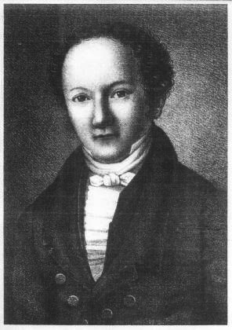
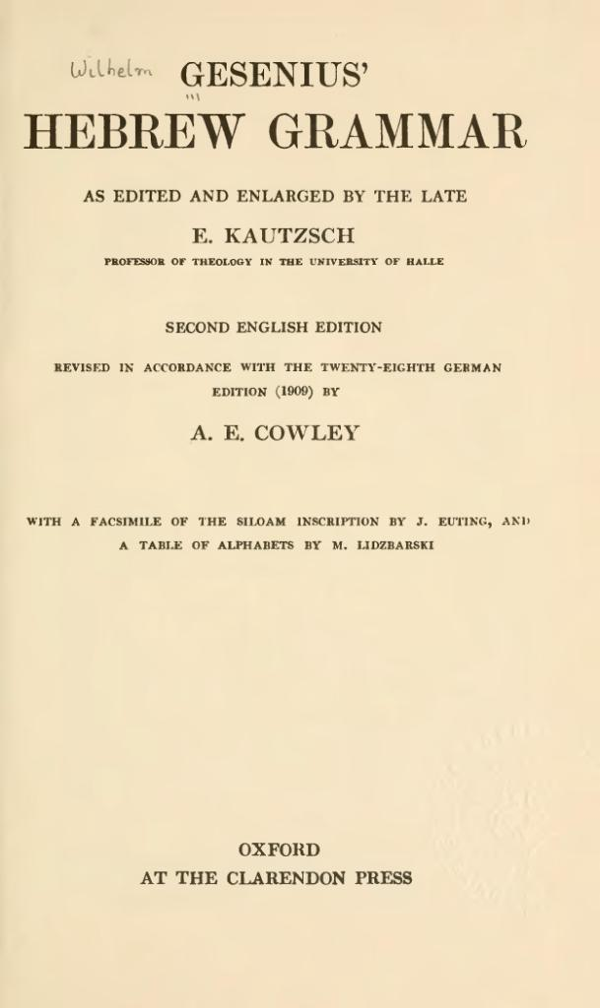
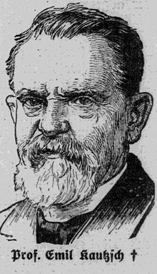
Reference Grammars
Classic Grammar
Monumental work
Scientific
Major influence on all subsequent Hebrew grammars
Originally published by Wilhelm Gesenius in 1813 when he was 27 years old
Underwent 28 editions
Revised by Emil Kautzsch
Translated into English by Arthur Cowley in 1910
Best edition known as GKC or Gesenius/Kautzsch/Cowley (1910)
In the public domain and available online
Comes as part of BibleWorks
ISBN 978-0486443447
Wilhelm Gesenius
Emil Kautzsch
http://en.wikisource.org/wiki/Gesenius'_Hebrew_Grammar
http://hebrewbiblescholar.com/gesenius/
Rocine 38 Reference Grammars

Slide 31
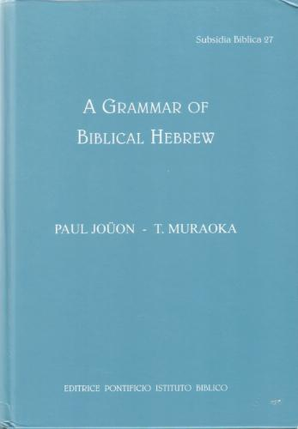
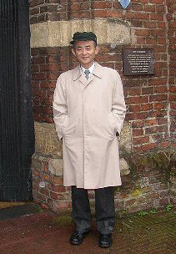
Reference Grammars
More up to date than GKC
First published by Paul Joüon in 1923 in French
Revised and translated by Takamitsu Muraoka in 1991 and 2001
Best version known as “Joüon-Muraoka”
Somewhat expensive; often comes in 2 volumes
Comes as part of BibleWorks
ISBN 978-8876536298
Takamitsu Muraoka
http://www.amazon.com/dp/8876536299/
http://hebrewbiblescholar.com/jouon-muraoka/
Rocine 38 Reference Grammars

Slide 32
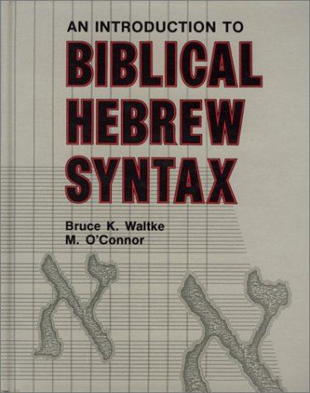
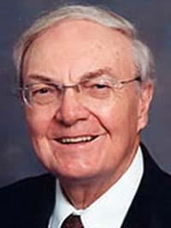
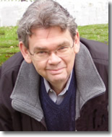
Reference Grammars
An important grammar for Hebrew syntax
Considerably easier to read than either GKC or JM
Modern terminology
Clear organization and layout
Lots of Hebrew examples and all are translated
Published by Bruce Waltke and Michael O’Connor in 1990
Referred to as “Waltke/O’Connor,” or “IBHS”
Comes as part of BibleWorks
ISBN 978-0931464317
Bruce Waltke
Michael O’Connor
http://www.amazon.com/dp/0931464315/
http://hebrewbiblescholar.com/waltke-oconnor/
http://www.sbl-site.org/publications/article.aspx?articleId=693
Rocine 38 Reference Grammars

Slide 33
Niphal yiqtol
וַיֹּ֫אמֶר אַבְרָהָם אָנֹכִי אִשָּׁבֵ֫עַ
There are 2 primary signs for the Niphal Yiqtol.
Auditory Sign:
i-a-ay sound
hireq/qamets/tsere
Visual Sign:
The ‘Niphal triangle’ at the front end
hireq/dagesh/qamets
Note that Piel yiqtol also has the i-a-ay sound but it will be shewa/patach/tsere and you’ll have the dagesh forte in the 2nd, not 1st root letter.
Compare:
Piel יְקַטֵּל
Niphal יִקָּטֵל
See Animated Hebrew lecture 26 for details.
Rocine 39 Niphal Yiqtol

Slide 34
The meaning of the Hitpael stem
וָאֶתְנַפַּל לִפְנֵי יְהוָה אֵת אַרְבָּעִים הַיּוֹם וְאֶת־אַרְבָּעִים הַלַּ֫יְלָה אֲשֶׁר הִתְנַפָּ֫לְתִּי
Root | Qal | Hithpael
ראה | See | Look at one another
הלך | Walk, go | Go to and fro
לקח | Take | Take hold of oneself, Flash about (said of lightening)
חזק | Be strong | Strengthen oneself
נשׂא | Lift | Exalt oneself
קדשׁ | Be holy | Display or celebrate one’s holiness
Rocine 42 Meaning of Hithpael

Slide 35
Adverbial Accusatives (def and indef)
וָאֶתְנַפַּל לִפְנֵי יְהוָה אֵת אַרְבָּעִים הַיּוֹם וְאֶת־אַרְבָּעִים הַלַּ֫יְלָה אֲשֶׁר הִתְנַפָּ֫לְתִּי
Examples of Accusatives (Direct Objects and Adverbial Accusatives of …)
I prostrated myself before YHWH [for] 40 days and 40 nights [Adverbial Accusative of TIME; Definite] | Deut 9:25 | Lesson verse above | 1
He divided [his troops] against them [in the] night [Adverbial Accusative of TIME; Indefinite, i.e. no את] | Genesis 14:15 | וַיֵּחָלֵ֙ק עֲלֵיהֶ֧ם׀ לַ֛יְלָה | 2
The woman was taken [to] house of Pharaoh [Adverbial Accusative of PLACE; Indefinite, i.e. no את] | Genesis 12:15 | וַתֻּקַּ֥ח הָאִשָּׁ֖ה בֵּ֥ית פַּרְעֹֽה׃ | 3
The land was filled [with] water [Adverbial Accusative of MATERIAL; Definite] | 2 Kings 3:20 | וַתִּמָּלֵ֥א הָאָ֖רֶץ אֶת־הַמָּֽיִם׃ | 4
And YHWH God formed the man [using] dust from the ground [the man = DIRECT OBJECT; Definite] [dust from the ground = Adverbial Accusative of MATERIAL; Indefinite, i.e. no את] | Genesis 2:7 | וַיִּיצֶר֩ יְהוָ֙ה אֱלֹהִ֜ים אֶת־הָֽאָדָ֗ם עָפָר֙ מִן־הָ֣אֲדָמָ֔ה | 5
Rocine 42 Adverbial Accusatives

Slide 36
Juridical Discourse
Legal code genre. Found especially in Exodus – Deuteronomy.
Apodosis
Protasis
כִּי or אִם ->(followed by)
 | Yiqtol <- Inf. Abs. | 1
… he shall surely be put to death. | מוֹת יוּמָת
 | לֹא Yiqtol + | 2
If he (a slave) continues a day or two, then he (an assailant) will not be punished. | אִם־יוֹם אוֹ יוֹמַ֫יִם יַעֲמֹד לֹא יֻקַּם
 | X-yiqtol | 3
If by himself he comes in, then by himself he will go out. | אִם־בְּגַפּוֹ יָבֹא בְּגַפּוֹ יֵצֵא
 | One or more weqatals | 4
And if the one with a discharge spit upon one who is clean, then he will wash his garments and rinse in water and he will be unclean until the evening. | וְכִי־יָרֹק הַזָּב בַּטָּהוֹר וְכִבֶּס בְּגָדָיו וְרָחַץ בַּמַּ֫יִם וְטָמֵא עַד־הָעָ֫רֶב׃
 | Yiqtol <- Subject | 1
A man who curses … | אִישׁ אֲשֶׁר יְקַלֵּל
 | Subject <- Yiqtol | 2
If an ox gores a man … | וְכִי־יִגַּח שׁוֹר אֶת־אִישׁ
 | Yiqtol followed by weqatals x-yiqtols | 3
If your brother becomes poor and sells part of his property… | כִּי־יָמוּךְ אָחִיךָ וּמָכַר מֵאֲחֻזָּתוֹ
Note: If the protasis ends with a weqatal clause and the apodosis begins with a weqatal clause the boundary between the protasis and apodosis can be challenging to find. E.g. compare Lev 25:25 in KJV and RSV.
Rocine 44 Juridical Discourse

Slide 37
Discourse Profile for Hortatory Discourse
Lesson 19
Mainline a. Imperative
b. Weqatal (for Mitigated Hortatory Discourse)
c. Jussive
d. Cohortative
Off-the-line:
Topicalization: X-Imperative / X-Jussive / X-Cohortative
Prohibitive Commands: אַל or לֹא + yiqtol
Express possibility: yiqtol
Consequence, purpose: Weqatal
Consequence, purpose: לֹא or פֶּן + yiqtol
Consequence, purpose: Embedded Predictive Narrative
Identification of problem: Embedded Historical Narrative
Backgrounded activities: Participle
Scene setting: Verbless Clause
Lesson 23
Lesson 24
Lesson 21.6b.4
Lesson 24.4
Lesson 21
Lesson 48
Lesson 22
Rocine 48 Subjunctive Yiqtol

Slide 38
Examples of Duals
Dual |  | Singular |  | Plural | Ref
עֵינַ֫יִם | Both eyes (757x) Gen 49:12 | עַ֫יִן | Eye (123x) Ex 21:24 ‘eye for eye’ | עֵינֹת עֲיָנֹת | Springs, Fountains (6x) Ex 15:17, Deut 8:7
שְׂפָתַ֫יִם | Both lips (101x) Ex 6:12 | שָׂפָה | Language, sea shore (68x) Gen 11:1, 22:17 | שִׂפְתוֹת | Lips (7x) Ecc 10:12
אָזְנַ֫יִם | Both ears (108x) Deut 29:3 | אֹ֫זֶן | Ear (79x) 2 Sam 22:45 | -
אַפַ֫יִם | Nostrils (42x) Gen 2:7 nostrils Gen 19:1 face | אַף | Nose, anger (235x) Gen 24:47 nose Gen 27:45 anger | -
שִׁנַּ֫יִם | Teeth (29x) Gen 49:12 teeth 1 Sam 2:13 ‘3 pronged fork’ ?? | שֵׁן | Tooth (26x) Ex 21:24 ‘tooth for tooth’ | - | Odd that it doesn’t occur in plural
יָדַ֫יִם | Both hands (251x) Gen 27:22 | יָד | Hand (1346x) Gen 3:22 | יָדוֹת | Hands (20x) Gen 43:34
רַגְלַ֫יִם | Both feet (163x) Lev 11:42 | רֶ֫גֶל | Foot, leg (78x) Gen 8:9 | רְגָלִים | Times (4x) Ex 23:14 ‘3 times a year …’
מָתְנַ֫יִם | Loins (47x) Ex 28:42 | - |  | -
כְּנָפַ֫יִם | Both wings Ex 25:20 | כָּנָף | Wing (37x) Gen 1:21 | כַּנְפוֹת | Wings, corners (56x) Deut 22:12 ‘4 corners of garment’
קַרְנַ֫יִם | Both horns (14x) Gen 22:13 | קֶ֫רֶן | Horn (29x) Josh 6:5 | קְרָנוֹת | Horns (32x) Zech 2:1
יוֹמַ֫יִם | Two days (5x) Ex 16:29 | יוֹם | Day (1451x) Gen 1:5 | יָמִים | Days, time (846x) Gen 4:3
Rocine 49 Examples of Duals

Slide 39
So… so far we have seen 3 “functions” for the Topicalization function.
I.e. the “X-something” syntax which topicalizes the “X” has performed 3 roles in Genesis 22 so far.
V. | Hebrew Text | Syntax | Function | Secondary Function or Role
1 | וְהָ֣אֱלֹהִ֔ים נִסָּ֖ה אֶת־אַבְרָהָ֑ם | X-Qatal | Topicalization | Summary | A summary statement that precedes the first wayyiqtol of the narrative. "Elohim tested Abraham" or "it was Elohim who was a tester of Abraham"
5 | וַאֲנִ֣י וְהַנַּ֔עַר נֵלְכָ֖ה עַד־כֹּ֑ה | X-Cohort | Topicalization | Focus switch | Focus switch from the two servants to Abraham and his son. “You two stay here. Me and the lad, we will go up there.”
8 | אֱלֹהִ֞ים יִרְאֶה־לּ֥וֹ הַשֶּׂ֛ה לְעֹלָ֖ה בְּנִ֑י | X-Yiqtol | Topicalization | Focus | Not a focus switch but focus on the answer to a central question in the passage. "It is Elohim who will provide..."
Rocine Reading 1 – Genesis 22:1-19 on page 281ff

